Slide 1
BI and AI Demand Forecasting, Replenishment, Dynamic Pricing
June 2023

Slide 2
Artificial Intelligence
Deep Learning:
special kind of ML algorithms using (deep) neural networks
BI / Data Science:
extract knowledge from data (by means of ML, among other things)
Machine Learning
Deep
Learning
Data Science

Slide 3
Automated Decision Making with AI in Retail
replenishment
avoid waste or out-of-stock situations (lost sales)
pricing
shape demand to maximize of revenue or profit
typically thousands of products and stores:
many individual decisions → automation crucial
decisions under uncertainty (random variables, many influencing factors) difficult for humans → statistical methods

Slide 4
Demand-Driven Decision Making
core component: demand forecasting
used in subsequent (or entangled) decision making
ordering / replenishment: minimization of costs for over- or under-fulfillment of demand
dynamic pricing: shape demand by altering its causes
(other possibility: individual customer targeting)

Slide 5
Demand in Supply Chains
different kinds of demand in supply chain
Supplier
Manufacturer
Distributor
Retailer
Customer
demand as orders
demand as sales
demand is a time-tagged random variable →
time series regression
BULLWHIP EFFECT

Slide 6
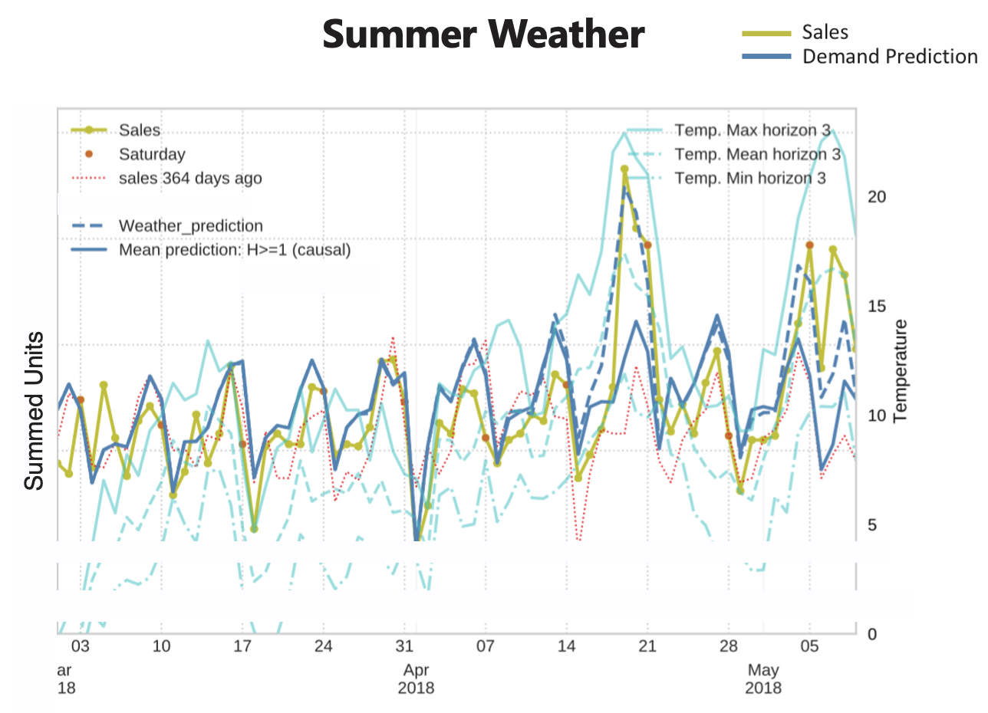
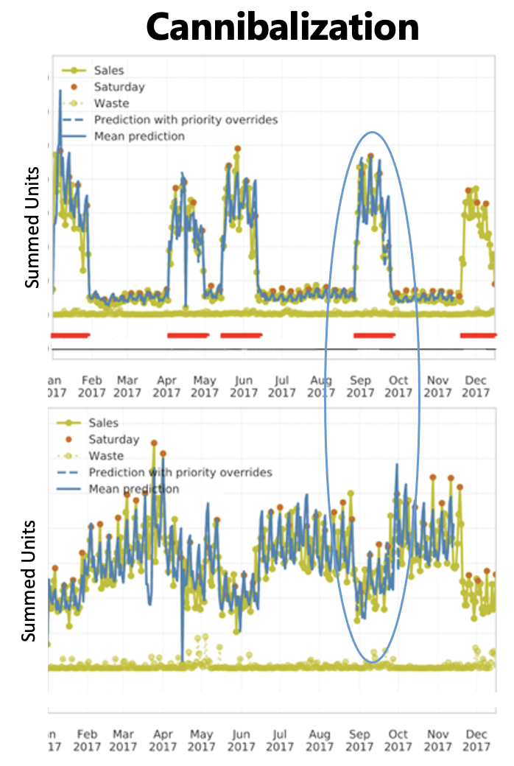
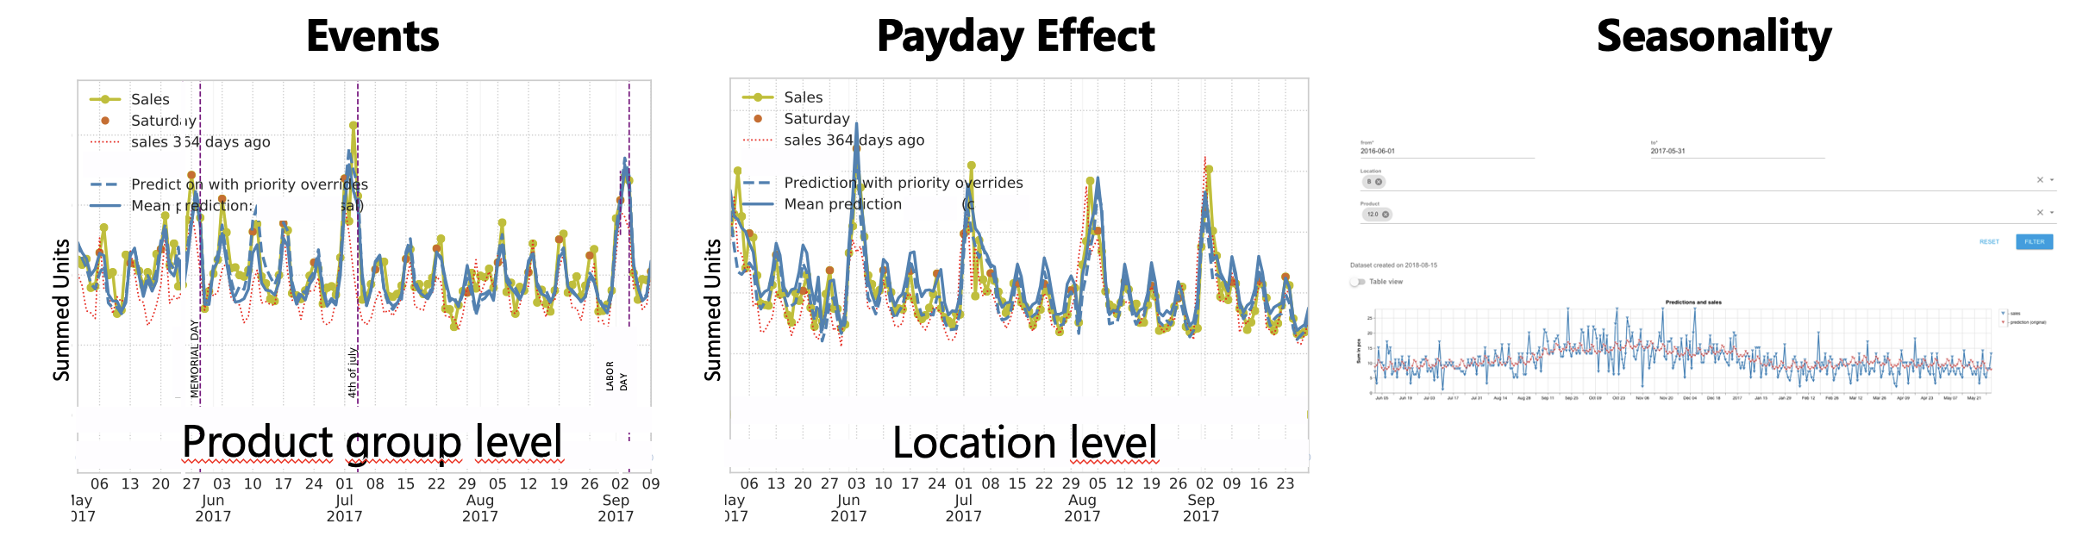
Demand in Retail

Slide 7
Time Series Modeling

Slide 8
Types of Time Series Forecasting Information
auto-correlation
using past values of considered time series as function of lag
identifying periodicity (seasonality) and trend
exogenous variables
using correlations of other variables to considered time series
examples in demand forecasting: price, weather
such effects lasting for some time create spurious auto-correlation

Slide 9
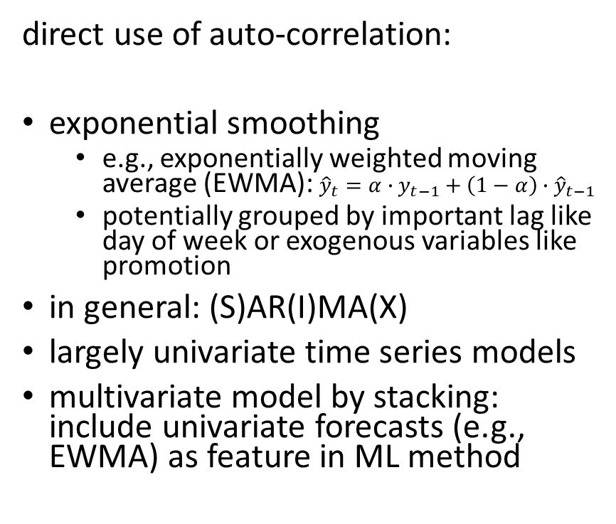
Traditional Forecasting Methods
direct use of auto-correlation:
exponential smoothing
e.g., exponentially weighted moving average (EWMA): ${\hat{y}}_{t}=α∙y_{t−1}+\left(1−α\right)∙{\hat{y}}_{t−1}$
potentially grouped by important lag like day of week or exogenous variables like promotion
in general: (S)AR(I)MA(X)
largely univariate time series models
multivariate model by stacking: include univariate forecasts (e.g., EWMA) as feature in ML method
decomposition-based approaches:
additive components: trend, seasonality, holidays, others
curve fitting (ML-like)
Generalized Additive Models (e.g., multiplicative effects)
example method: prophet
natural way for multivariate model: training with several independent time series, distinguished by additional feature (e.g., product ID)

Slide 10

Demand Forecasting with ML
many individual time series to consider
advantages of ML over traditional univariate time series forecasting:
typical retail grocery chain:
products (items): ~20k
locations (stores): ~500
daily/hourly aggregated sales
combined learning on all time series of product-location combinations (rather than separately optimizing individual time series)
→ reduces variance by exploiting commonalities
natural consideration of many exogenous variables (prices, promotions, holidays, weather, ...)
→ reduces bias
promotions
(price reductions)
Summed Units
to be noted:
categorical features important (products and locations → high cardinality)
mainly multiplicative effects
demand (approximately) following Poisson (or rather negative binomial) distribution

Slide 11
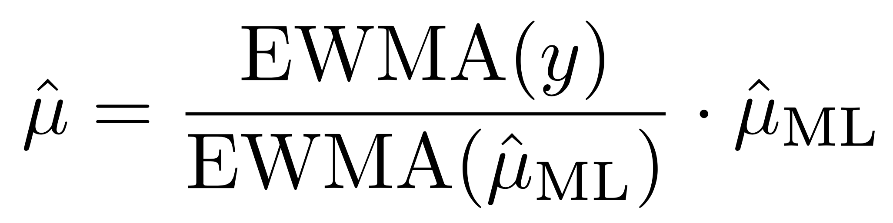
Beware of (Spurious) Auto-Correlation
Most forecasting methods rely on lagged target information.
univariate time series methods
exponential smoothing features in ML model
sequence modeling in deep learning (e.g., recurrent neural networks)
However, this makes learning of exogenous effects much harder.
already blended in target auto-correlation
delayed effects of short-lived structures/trends
simple solution: no use of target auto-correlation in ML model (but subsequent residual correction to capture missing trends)
one product group summed over all locations
COVID-19
difficult

Slide 12
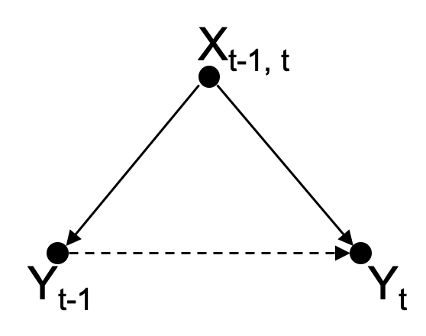
Temporal Confounding
auto-correlation often only spurious: common causes at consecutive times
→ no direct causal effects
advantages of learning direct causal effects from exogenous information instead of confounded auto-correlation:
explainability
long-term forecasting
predictability of rare events

Slide 13
Quick Introduction to ML

Slide 14
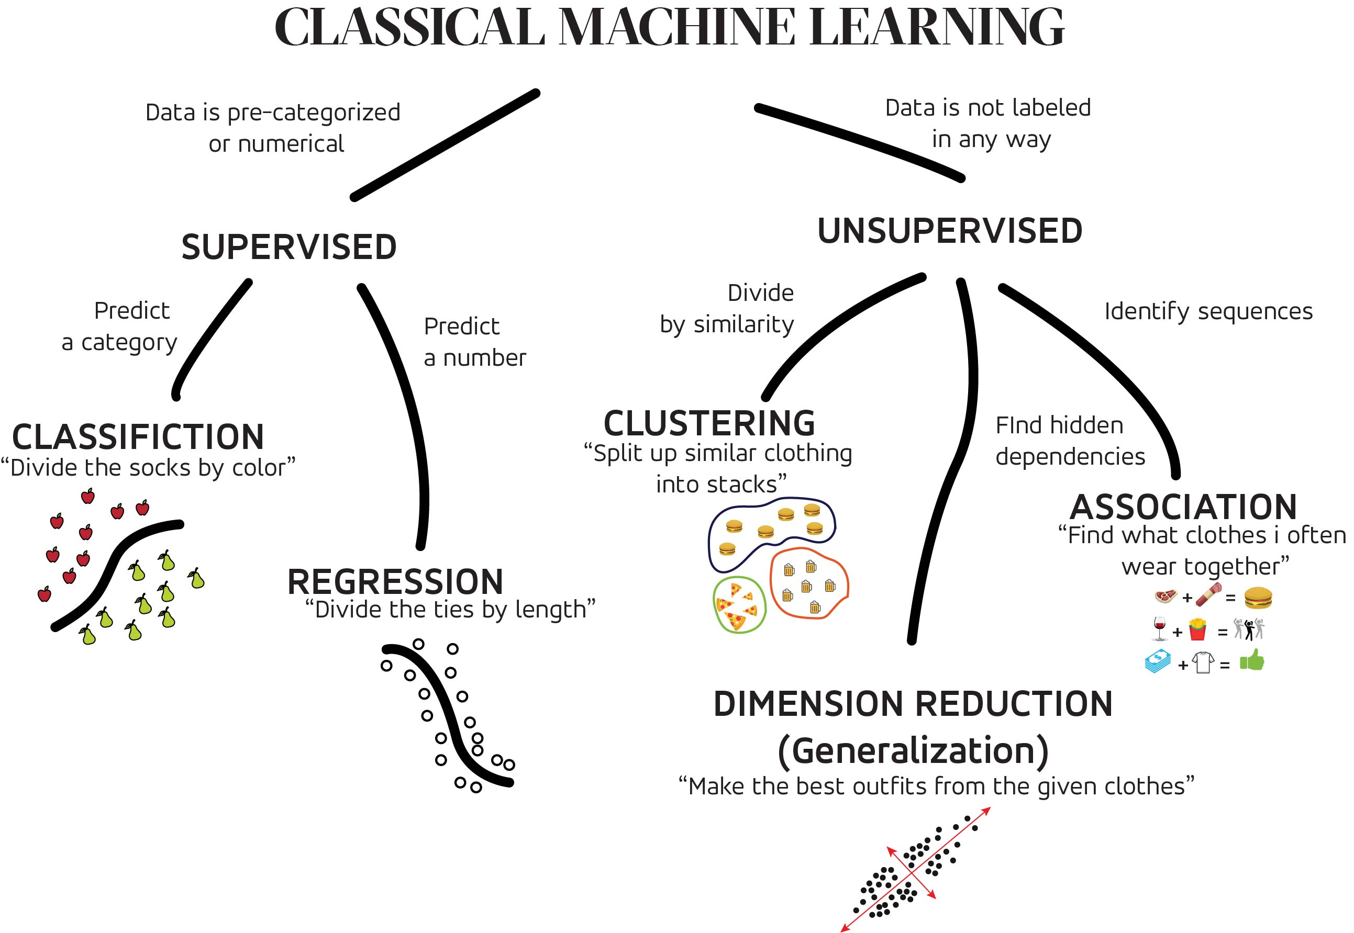
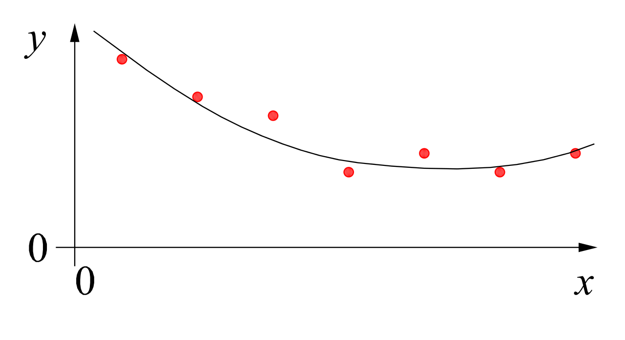


MACHINE LEARNING
no supervision, but goal-based interaction with environment
training target available (labeled or past data)
data not labeled in any way
REINFORCEMENT LEARNING
SUPERVISED
UNSUPERVISED
CLASSIFICATION
ASSOCIATION
CLUSTERING
LEARN STATE OR ACTION VALUES
LEARN POLICY DIRECTLY
REGRESSION
DIMENSIONALITY REDUCTION
learning by teacher
(high-dimensional curve fitting)
learning by observation
(pattern recognition)
learning by trial-and-error
(sequential decision making)

Slide 15


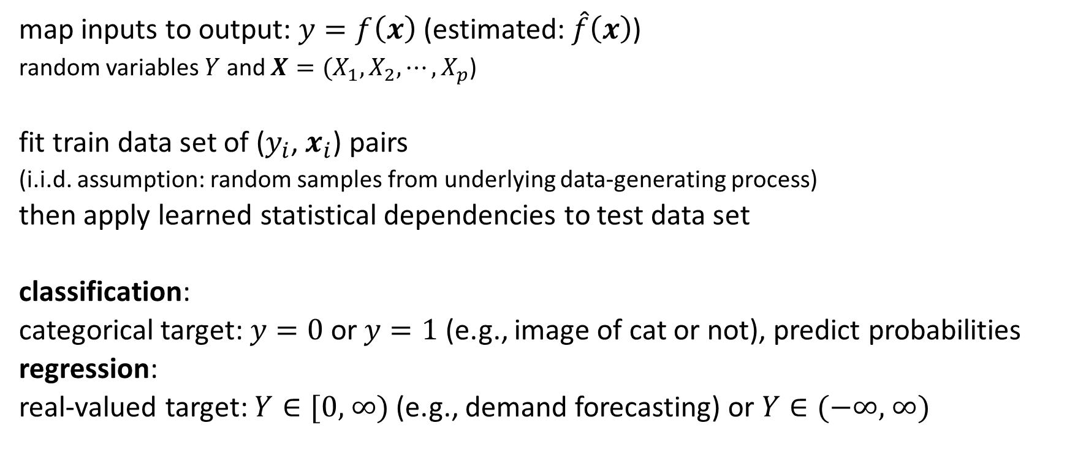
Supervised Learning Scenario
… ML …
ML domain:
no deterministic dependencies between input and output
map inputs to output: $y=f\left(x\right)$ (estimated: $\hat{f}\left(x\right)$)
random variables $Y$ and $X={(X}_{1}, X_{2},{⋯,X}_{p}$)
fit train data set of ($y_{i}$, $x_{i}$) pairs
(i.i.d. assumption: random samples from underlying data-generating process)
then apply learned statistical dependencies to test data set
classification:
categorical target: $y=0$or $y=1$ (e.g., image of cat or not), predict probabilities
regression:
real-valued target: $Y∈\text{[0, ∞)}$ (e.g., demand forecasting) or $Y∈\text{(−∞, ∞)}$
usually many dimensions

Slide 16

Algorithmic Families
linear (parametric) models
nearest neighbors (local methods, instance-based learning) – non-parametric models
decision trees
linear regression
Generalized Linear Models
Generalized Additive Models
Day
Weekday
Weekend
3
neural networks: non-linear just by means of activation functions
Promo
No
Yes
demand prediction
5
8
often used in ensemble methods
bagging: random forests
boosting: gradient boosting
kernel/support-vector machines: linear model (maximum-margin hyperplane) with kernel trick
from wikipedia

Slide 17
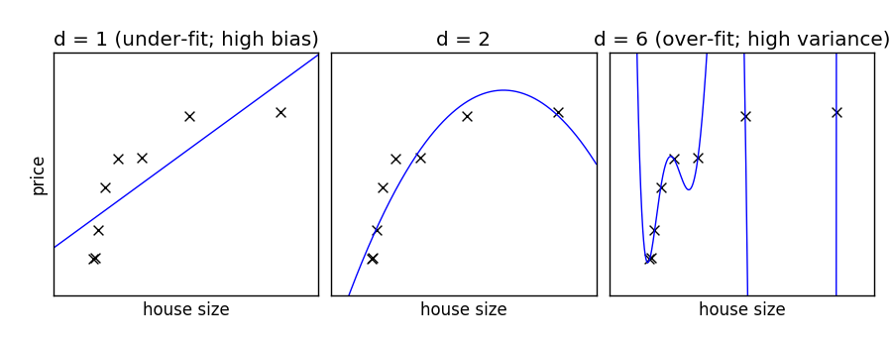
Common Core of Statistical Learning
curve fitting (e.g., least squares method or maximum likelihood estimation)
through optimization methods (e.g., gradient descent)
with the aim of generalization (by means of regularization techniques)
from scikit-learn documentation
At its heart, all the diverse statistical learning methods are reflections of the same underlying concept, and just differ in their applicability for different use cases.

Slide 18
Count Data & Multiplicative Effects: Generalized Linear Models

Slide 19

Linear Regression
error term (noise): reflects assumed data distribution (here: Gaussian with same variance $σ^{2}$ for all samples)
$$\hat{f}\left(x_{i}\right)$$
from wikipedia
fit:
parameters to be estimated:
$\hat{α},\hat{β}$
${\hat{σ}}^{2}=$ $\frac{1}{n}\sum_{i=1}^{n}{{\left(y_{i}−\hat{f}\left(x_{i}\right)\right)}^{2}}$
(approximating assumed true $α, β$, $σ$)
$$y_{i}=\hat{α}+\sum_{j=1}^{p}{{\hat{β}}_{j} x_{ij}}+ε_{i}$$
(model)
predict:
$$p\left(y|x_{i}\right)=𝒩\left(y;{\hat{y}}_{i}, {\hat{σ}}^{2}\right)$$
$${\hat{y}}_{i}=E\left[Y|X=x_{i}\right]=\hat{f}\left(x_{i}\right)$$
Gaussian
mean
variance
(reflected by $ε_{i}$ in fit)
conditional mean for squared loss of least squares method
predict arbitrary quantile by means of quantile loss

Slide 20
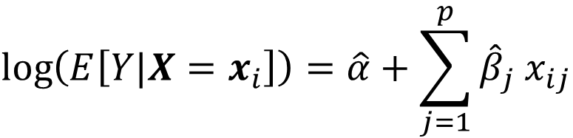
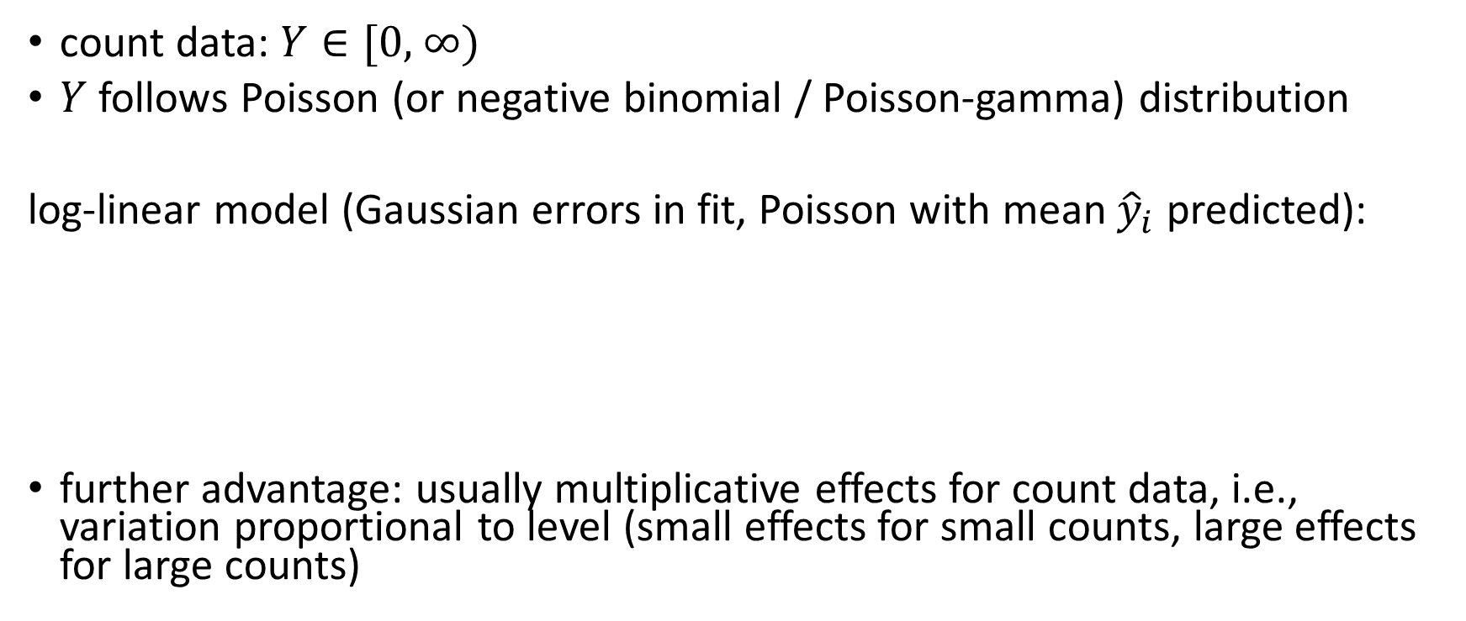
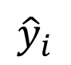
Multiplicative Model
count data: $Y∈\text{[0, ∞)}$
$Y$ follows Poisson (or negative binomial / Poisson-gamma) distribution
log-linear model (Gaussian errors in fit, Poisson with mean ${\hat{y}}_{i}$ predicted):
further advantage: usually multiplicative effects for count data, i.e., variation proportional to level (small effects for small counts, large effects for large counts)
$$\log\left(E\left[Y|X=x_{i}\right]\right)=\hat{α}+\sum_{j=1}^{p}{{\hat{β}}_{j} x_{ij}}$$
single parameter
link function
$${\hat{y}}_{i}$$

Slide 21
Sidenote: Classification by Logistic Regression
predict probability $p_{i}$ for $y=1$ respectively $y=0$ for each sample
link function: logit (log-odds)
$Y$ following Bernoulli distribution
$$\operatorname{logit}\left(E\left[Y|X=x_{i}\right]\right)=\ln\left(\frac{p_{i}}{1−p_{i}}\right)⁡=\hat{α}+\sum_{j=1}^{p}{{\hat{β}}_{j} x_{ij}}$$

Slide 22
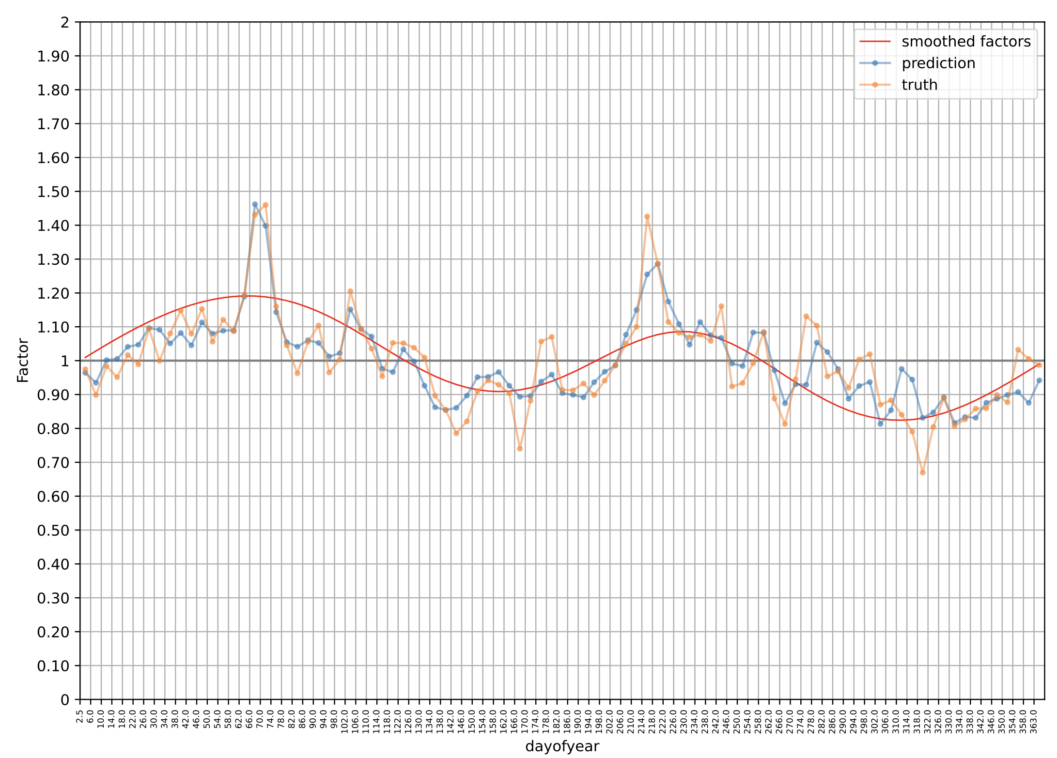
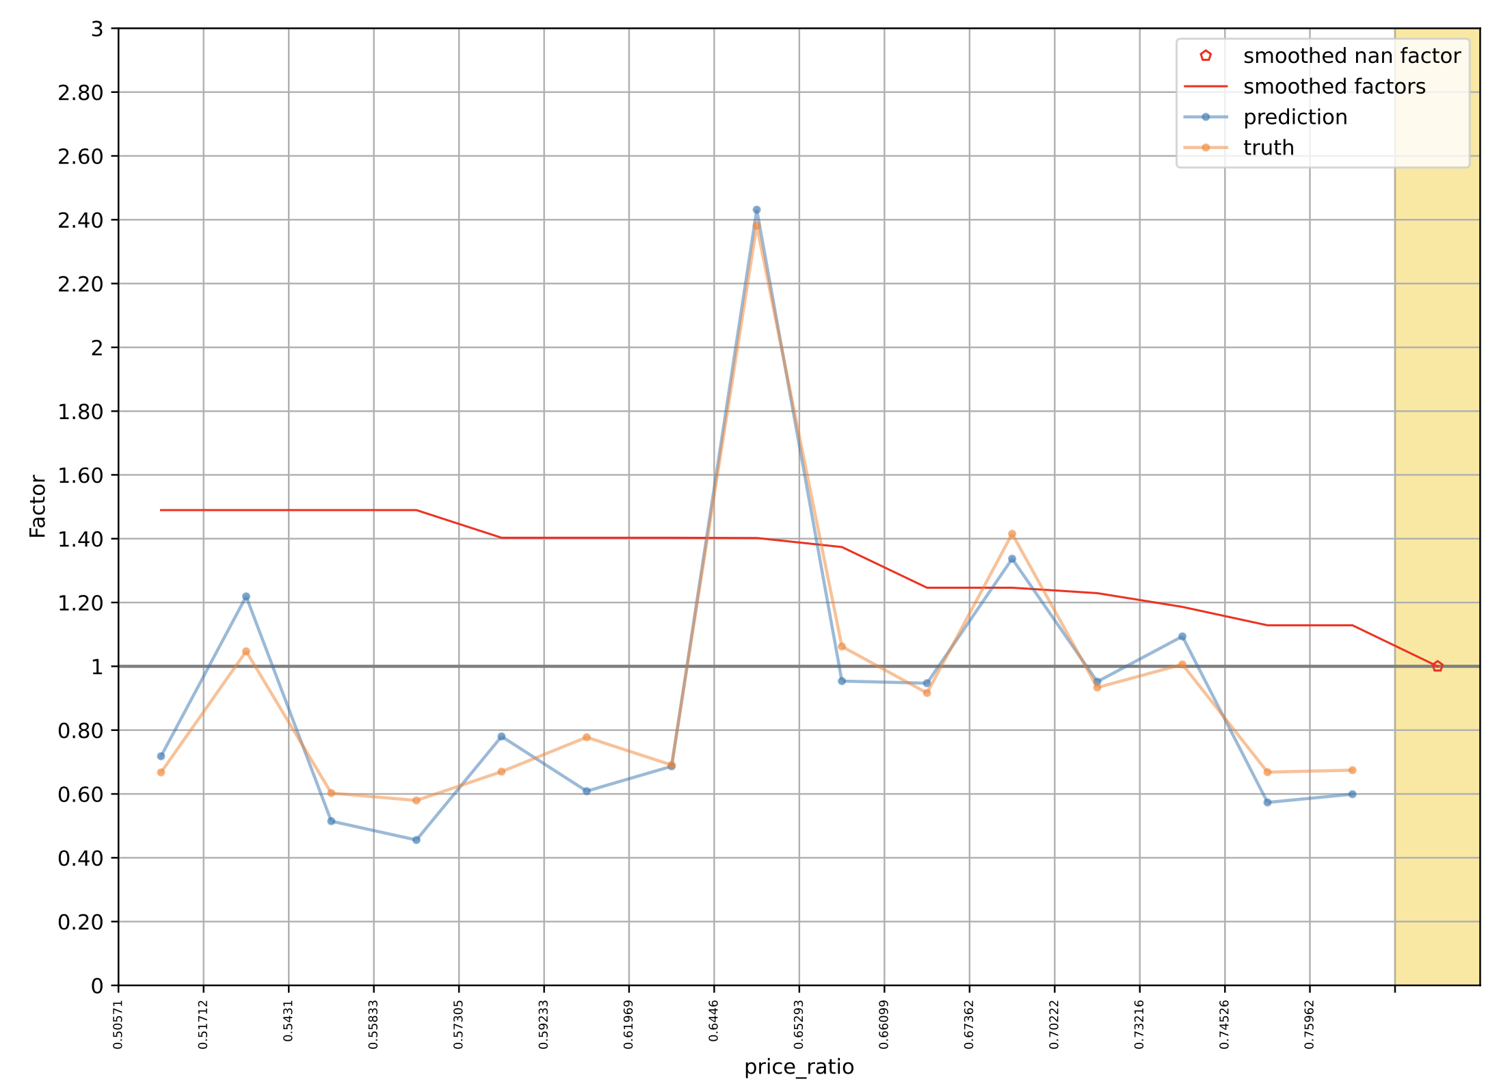
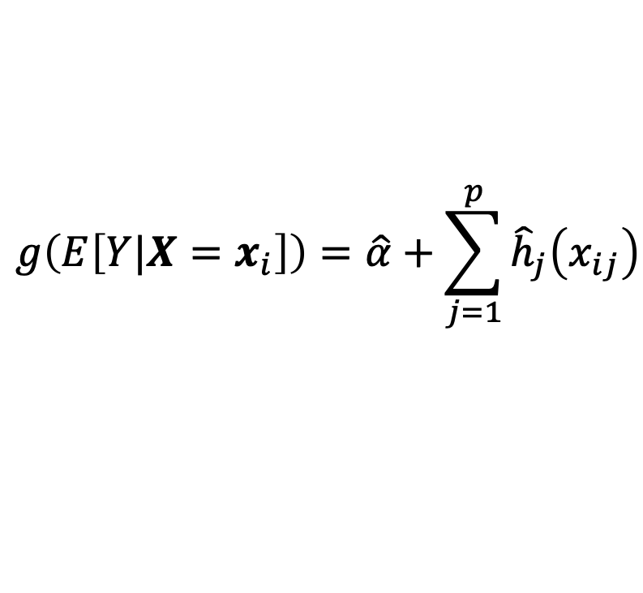
Generalized Additive Models
Cyclic Boosting
sinusoidal functions
blending of Generalized Linear Models and additive models
$$g\left(E\left[Y|X=x_{i}\right]\right)=\hat{α}+\sum_{j=1}^{p}{{\hat{h}}_{j}\left(x_{ij}\right)}$$
smooth functions
potentially non-parametric form
describe non-linear effects
estimated, e.g., via backfitting algorithm
extension: add interaction terms between different features (e.g., different holiday effects for different products)
monotonic requirements

Slide 23
Automatic Interaction Learning: Gradient Boosting

Slide 24
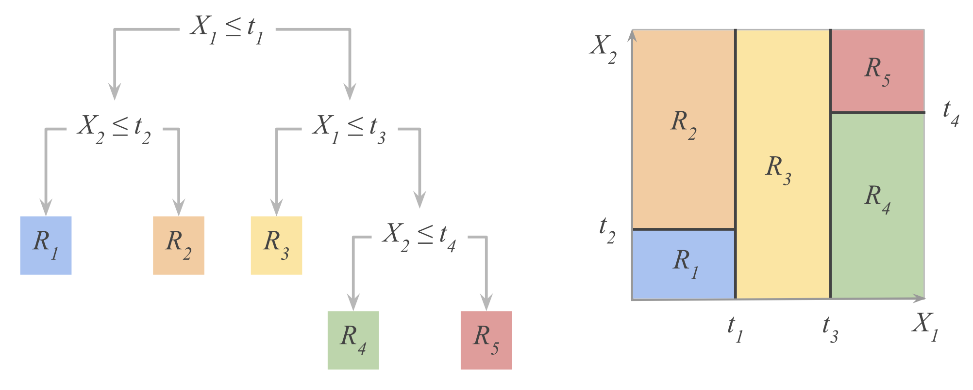
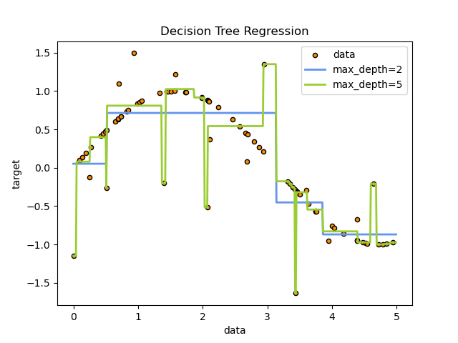
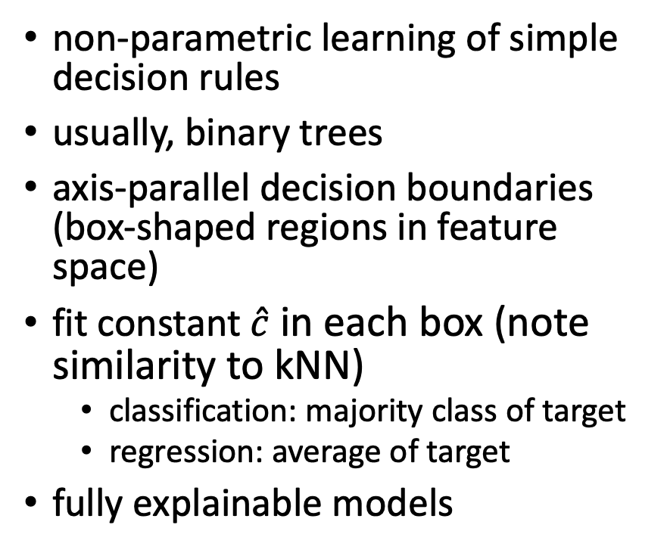
Decision Trees
non-parametric learning of simple decision rules
usually, binary trees
axis-parallel decision boundaries (box-shaped regions in feature space)
fit constant $\hat{c}$ in each box (note similarity to kNN)
classification: majority class of target
regression: average of target
fully explainable models
from Hastie
from scikit-learn

Slide 25
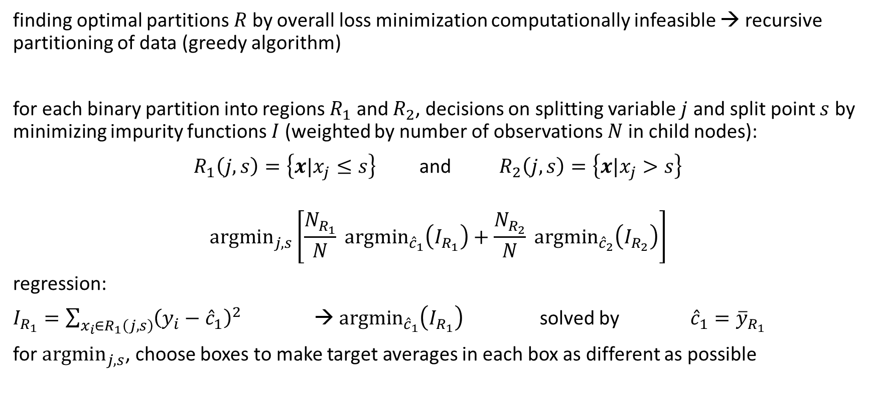
Decision Tree Learning
finding optimal partitions $R$by overall loss minimization computationally infeasible → recursive partitioning of data (greedy algorithm)
for each binary partition into regions $R_{1}$ and $R_{2}$, decisions on splitting variable $j$ and split point $s$ by minimizing impurity functions $I$ (weighted by number of observations $N$in child nodes):
$R_{1}\left(j,s\right)=\left\{x|x_{j}≤s\right\}$ and $R_{2}\left(j,s\right)=\left\{x|x_{j}>s\right\}$
$${argmin}_{j,s}\left[\frac{N_{R_{1}}}{N} {argmin}_{{\hat{c}}_{1}}\left(I_{R_{1}}\right)+\frac{N_{R_{2}}}{N} {argmin}_{{\hat{c}}_{2}}\left(I_{R_{2}}\right)\right]$$
regression:
$I_{R_{1}}=\sum_{x_{i}∈R_{1}\left(j,s\right)}{{\left(y_{i}−{\hat{c}}_{1}\right)}^{2}}$ → ${argmin}_{{\hat{c}}_{1}}\left(I_{R_{1}}\right)$ solved by ${\hat{c}}_{1}={\overline{y}}_{R_{1}}$
for ${argmin}_{j,s}$, choose boxes to make target averages in each box as different as possible
recursively for each node in tree

Slide 26
Boosting
idea: sequentially learn and combine several “weak” learners (such as small decision trees, but in principle any ML algorithm) to construct a “strong” one
→ gradually (in a greedy fashion) reducing bias of ensemble model
in simple terms: building a model from the training data, then creating a second model that attempts to correct the errors from the first model, …
→ each subsequent weak learner is forced to concentrate on the examples that are missed by the previous ones in the sequence
not a committee of models
typically, use simple, high-bias methods as individual models

Slide 27

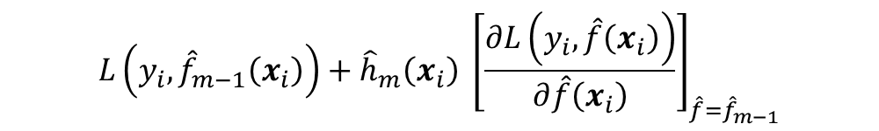
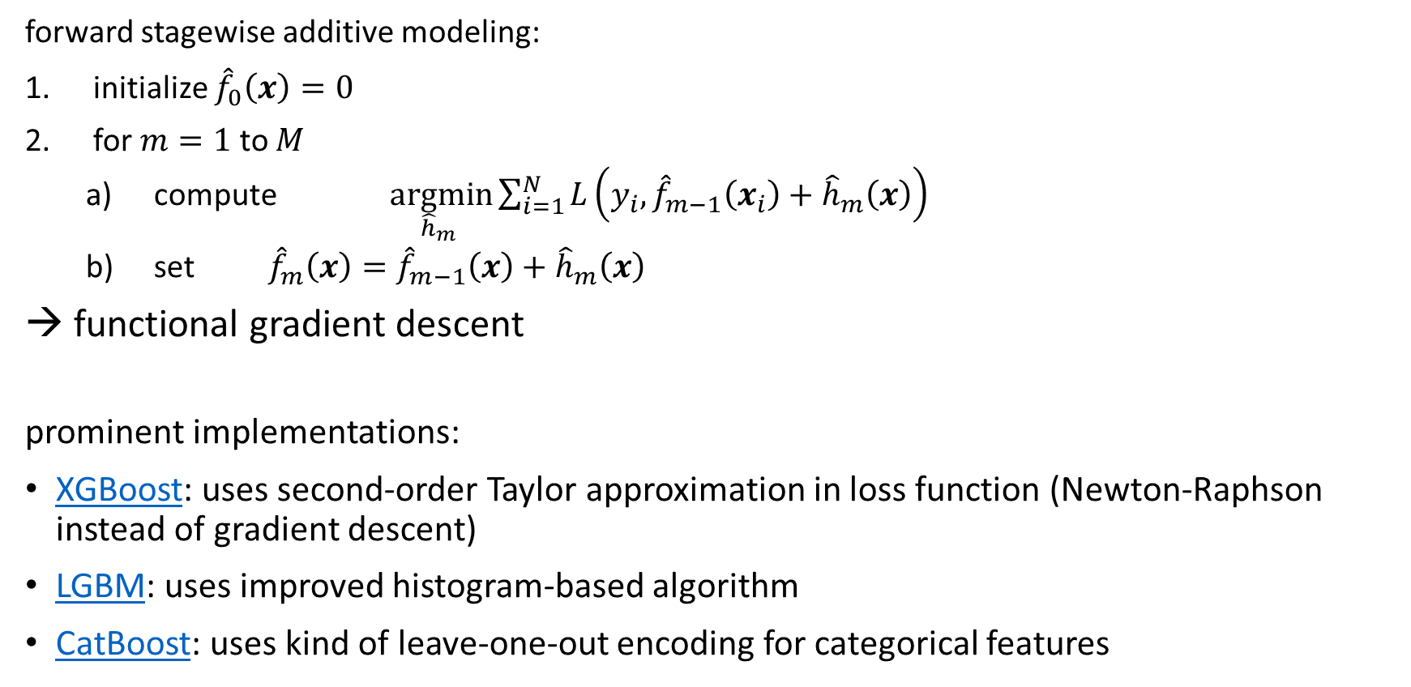
Gradient Boosting
forward stagewise additive modeling:
initialize ${\hat{f}}_{0}\left(x\right)=0$
for $m=1$ to $M$
compute $\underset{{\hat{h}}_{m} }{argmin}{\sum_{i=1}^{N}{L\left(y_{i},{\hat{f}}_{m−1}\left(x_{i}\right)+{\hat{h}}_{m}\left(x\right)\right)}}$
set ${\hat{f}}_{m}\left(x\right)={\hat{f}}_{m−1}\left(x\right)+{\hat{h}}_{m}\left(x\right)$
→ functional gradient descent
prominent implementations:
XGBoost: uses second-order Taylor approximation in loss function (Newton-Raphson instead of gradient descent)
LGBM: uses improved histogram-based algorithm
CatBoost: uses kind of leave-one-out encoding for categorical features
$$L\left(y_{i},{\hat{f}}_{m−1}\left(x_{i}\right)\right)+{\hat{h}}_{m}\left(x_{i}\right) {\left[\frac{∂L\left(y_{i}, \hat{f}\left(x_{i}\right)\right)}{∂\hat{f}\left(x_{i}\right)}\right]}_{\hat{f}={\hat{f}}_{m−1}}$$
$$≈$$

Slide 28
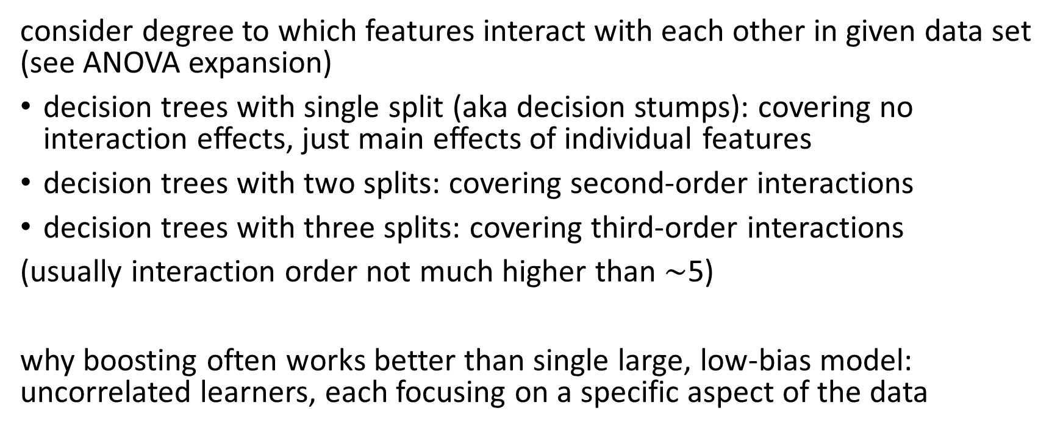
Decision Tree Sizes for Boosting
consider degree to which features interact with each other in given data set (see ANOVA expansion)
decision trees with single split (aka decision stumps): covering no interaction effects, just main effects of individual features
decision trees with two splits: covering second-order interactions
decision trees with three splits: covering third-order interactions
(usually interaction order not much higher than $\sim$5)
why boosting often works better than single large, low-bias model: uncorrelated learners, each focusing on a specific aspect of the data

Slide 29
Embeddings & Feature Learning: Deep Learning

Slide 30
Categorical Variables
tabular data usually heterogenous, often with sparse categorical variables (like color of an object)
→ need for an encoding for categorical variables
different possibilities:
ordinal encoding
leave-one-out encoding (use mean of target for given category excluding current row)
one-hot encoding (suffers from curse of dimensionality)
embeddings
stacking:
X.sort_values(['date’])
.groupby(['store','item'])['y’]
.apply(lambda x: x.shift(3)
.ewm(alpha=0.15).mean())
prediction horizon

Slide 31
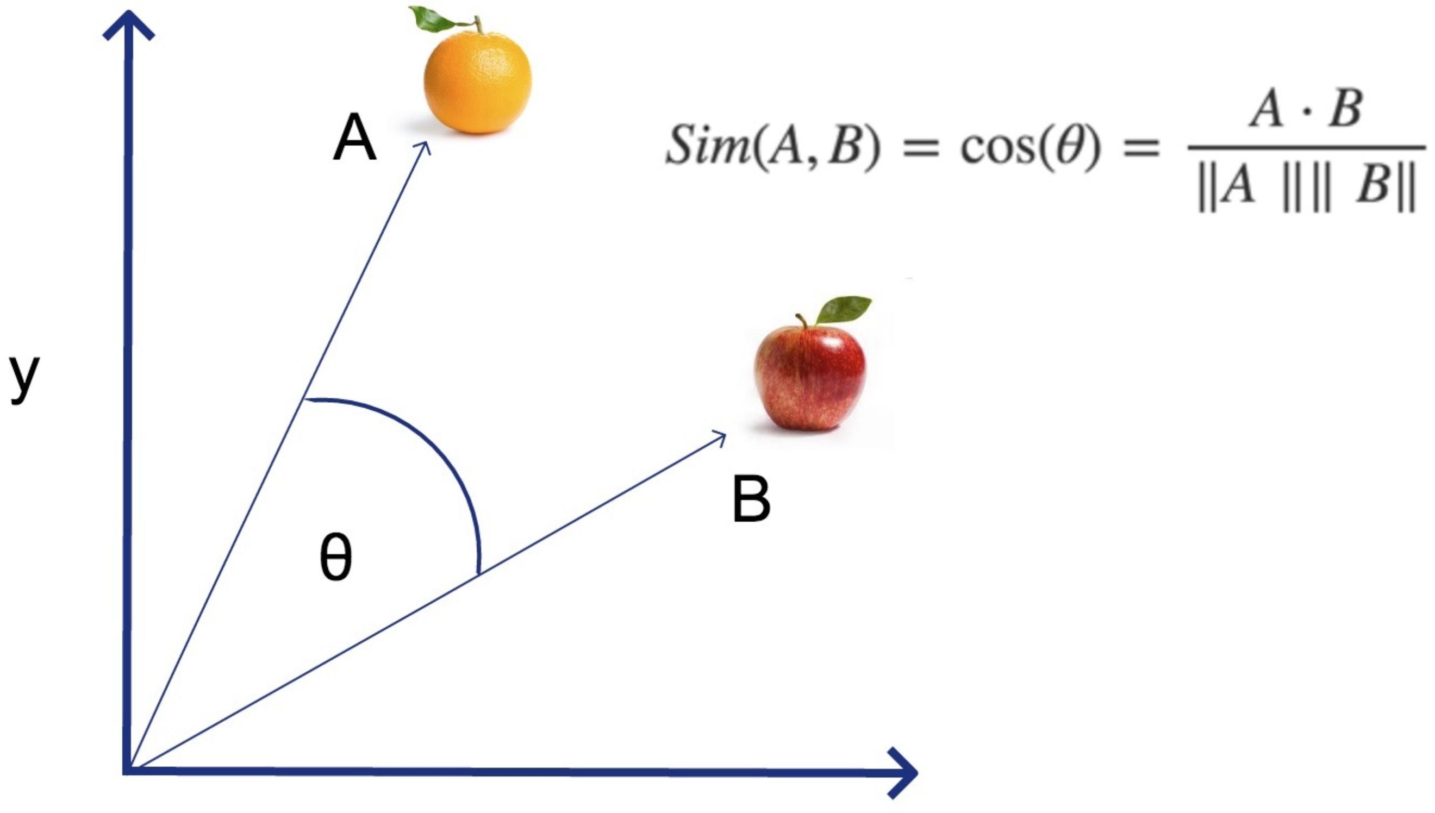
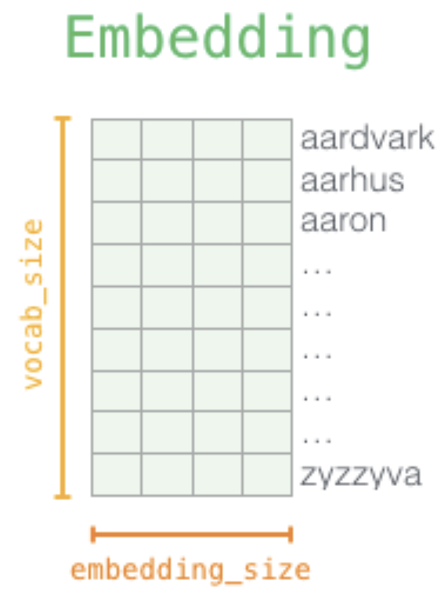
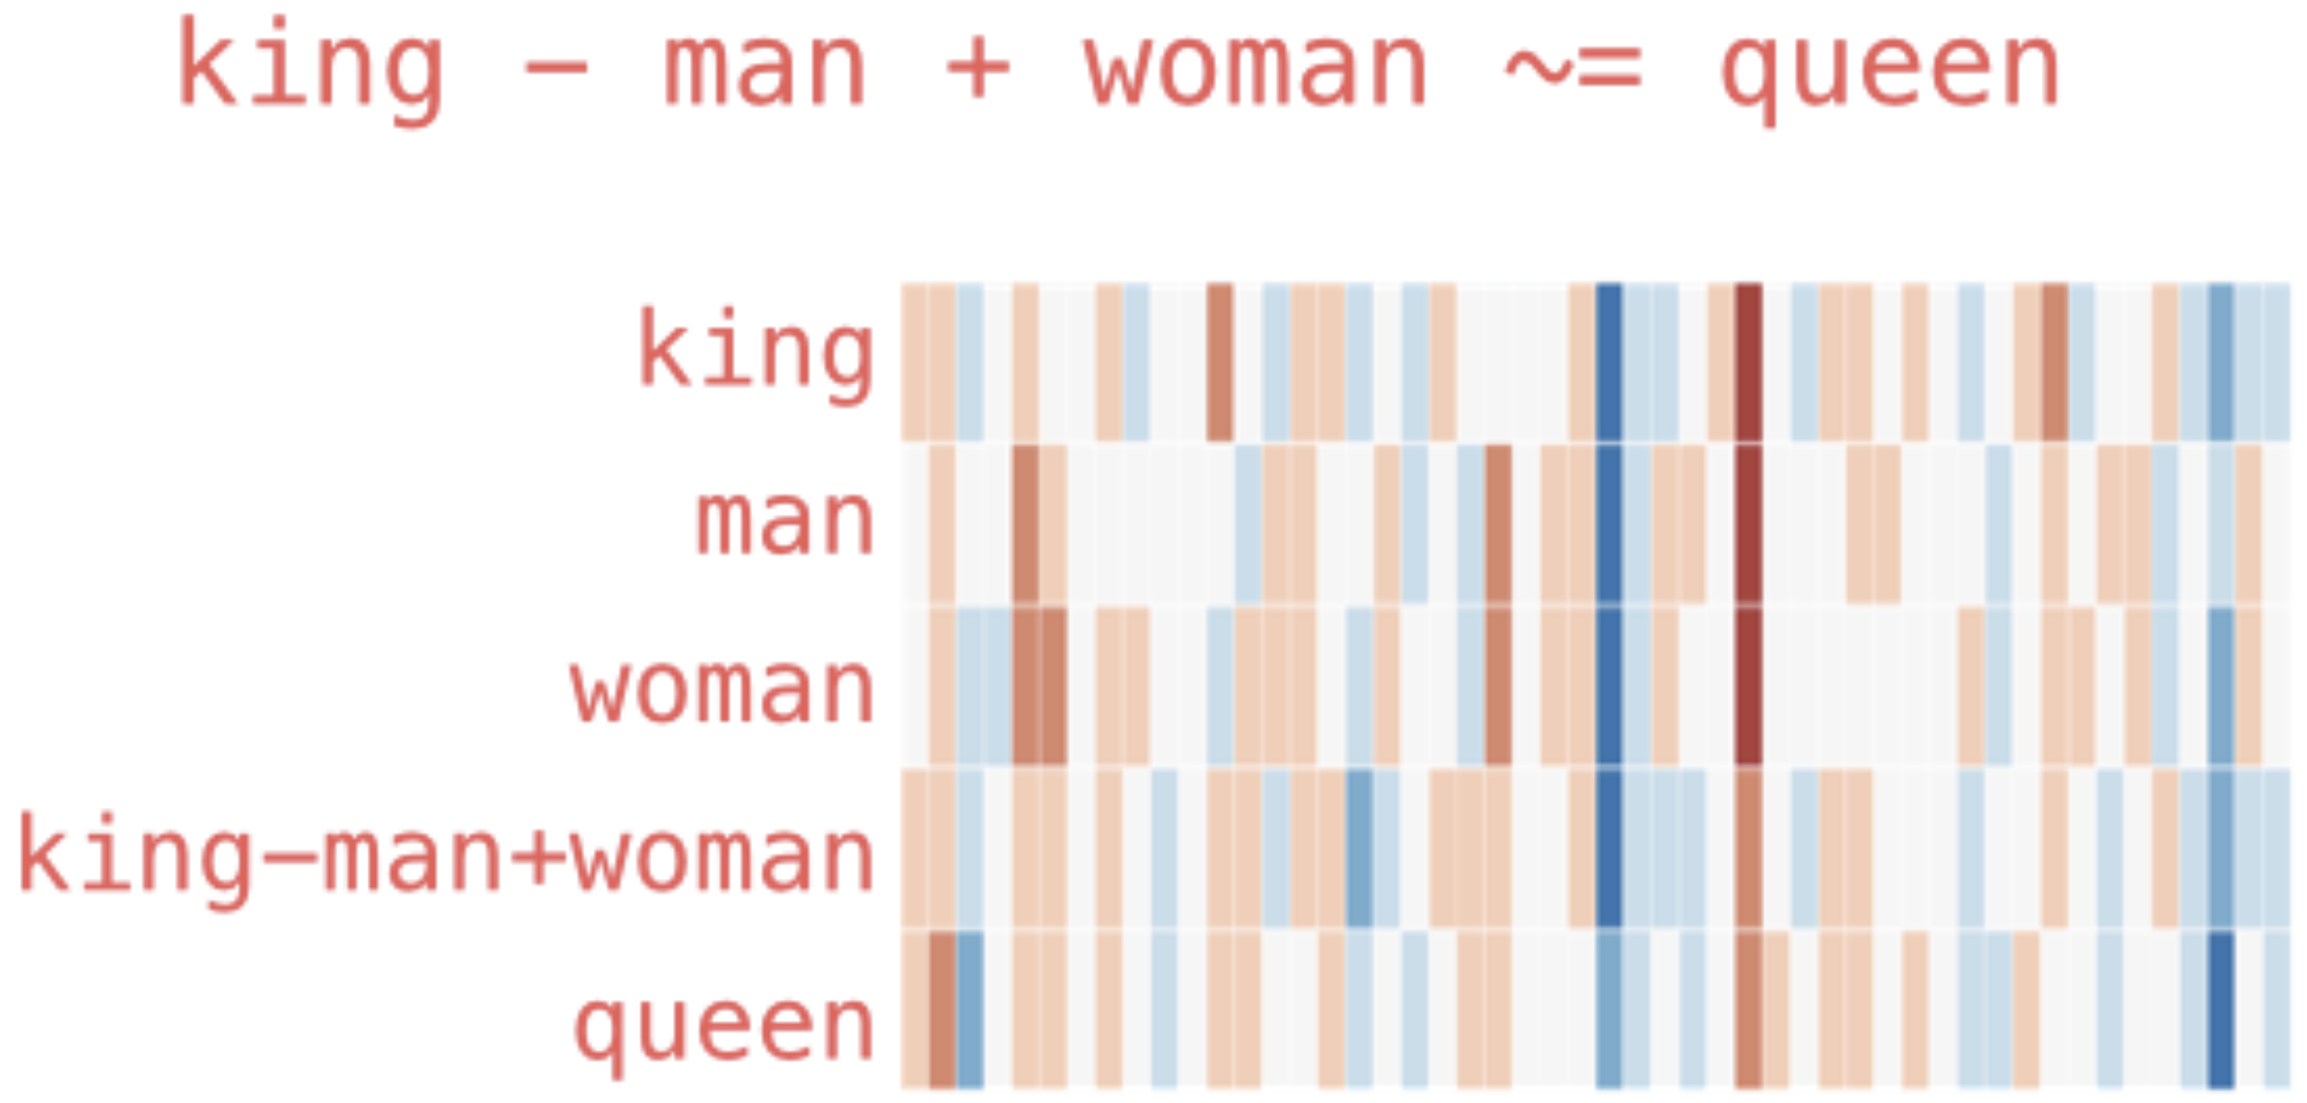
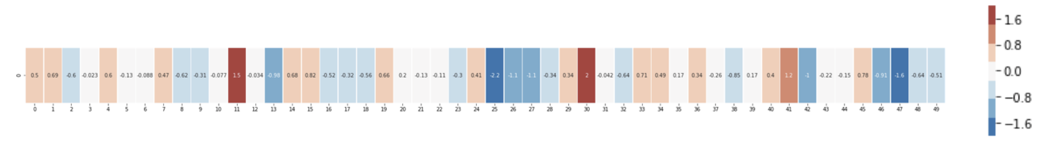
Embeddings
representation of entities by vectors
similarity between embeddings by, e.g., cosine similarity → semantic similarity
most famous application: word embeddings → associations (natural language processing)
but general concept: embeddings of (categorical) features (e.g., products in recommendation engines)
end-to-end learning: embeddings layer in deep neural network, e.g., multi-layer perceptron (MLP)
but also direction of difference vectors interesting (analogies):
source

Slide 32
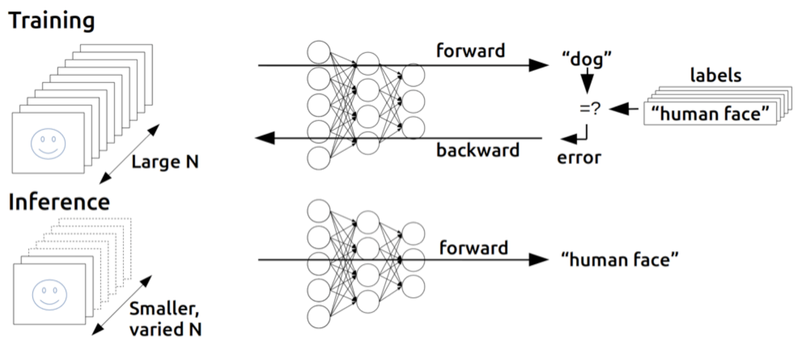
(Deep) Neural Networks
back-propagation of errors (gradients of cost function according to weights) through layers via chain rule of calculus (avoiding redundant calculations of intermediate terms)
each node exchanges information only with directly connected nodes → enables efficient, parallel computation
forward pass: current weights fixed, predictions computed
backward pass: errors computed from predictions and back-propagated → weights then updated according to loss gradients (via gradient descent)
source

Slide 33
Examples for Feature Engineering
seasonality
day of week, payday, week of year
weather
event-like: first sunny weekend, snowstorm, …
events (e.g., holidays)
time window around event (e.g., monotonic)
promotion
days since start of promotion period
price
ratio of reduced and normal price, price-demand elasticity
product information
text (name/description) or image embeddings

Slide 34
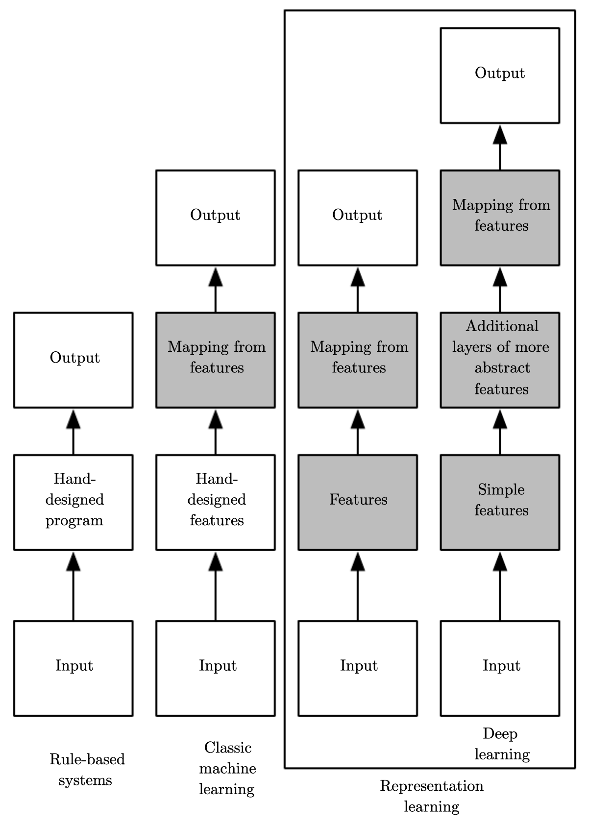
Feature Engineering vs Feature Learning
shallow learning:
representation encoded in features
→ feature engineering
deep learning:
representation encoded in network
→ feature/representation learning
(hierarchy of concepts learned from raw data in deep graph with many layers)
source

Slide 35
Tabular vs Unstructured Data
deep learning methods dominate applications on unstructured data (like text or images), but not necessarily on tabular data
typical characteristics of tabular data difficult to handle for deep learning:
irregular patterns in target function (neural networks require piecewise continuous targets)
uninformative features
non-rotationally invariant data (linear combinations of features misrepresent the information)
tree-based models (e.g., gradient boosting) can naturally deal with these situations

Slide 36
Black-Box Models
To build trust in AI systems, individual predictions/actions need to be fully transparent, i.e., explainable.
(do not confuse explainability with causality though)
Unfortunately, complex models like deep learning methods are difficult to interpret.
→ need for model-agnostic methods to explain black-box models
examples: local surrogates (LIME), Shapley values (SHAP)
overview

Slide 37
Deep Learning Methods for Sequential Data
→ direct inclusion of auto-correlation in ML model (but remember: mainly spurious)
convolutional neural networks (CNN)
main application computer vision: images correspond to regular 2D grids of data (pixels)
time series data as 1D grid at regular time intervals
parameter sharing via convolutions (and pooling) → highly regularized feed-forward networks
fixed time window (kernel)
multivariate time series model via different input channels
recurrent neural networks (RNN)
main application natural language processing (NLP): sequence of words (tokens)
time series data as time-tagged stream
parameter sharing via recurrent nodes → context-awareness (input from past activations)
variable-length time series
multivariate time series model via more input nodes
transformers
main application NLP (largely replaced RNNs), but also computer vision
time series data as directed graph (attention in edges)
masked self-attention to focus on relevant past time steps and positional encoding to include order of sequence
multivariate time series model via input concatenation

Slide 38
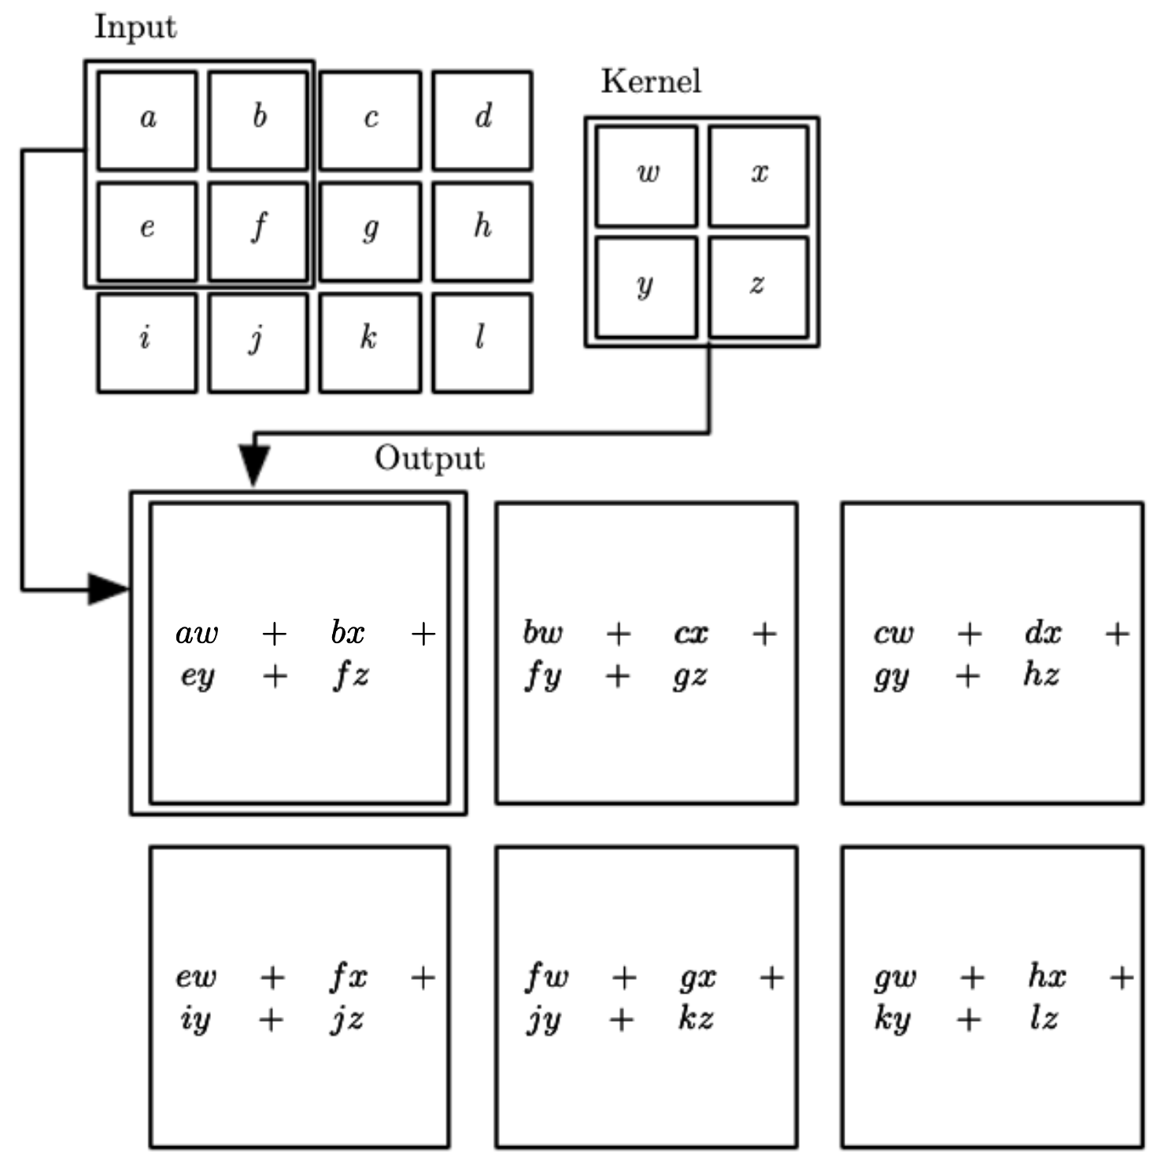

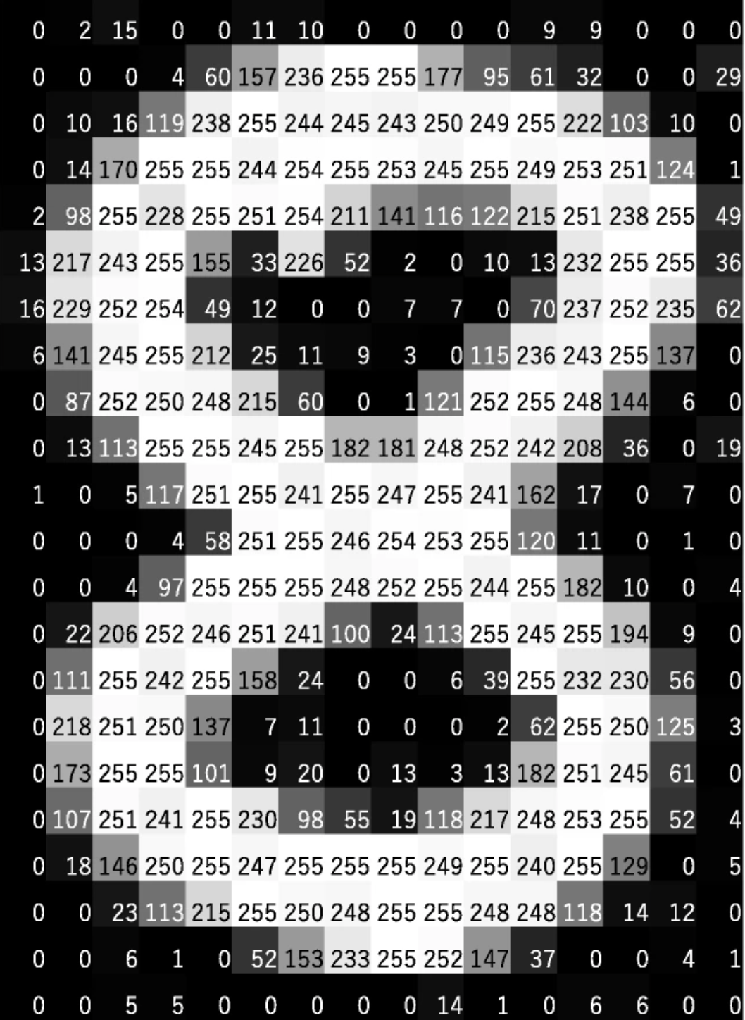
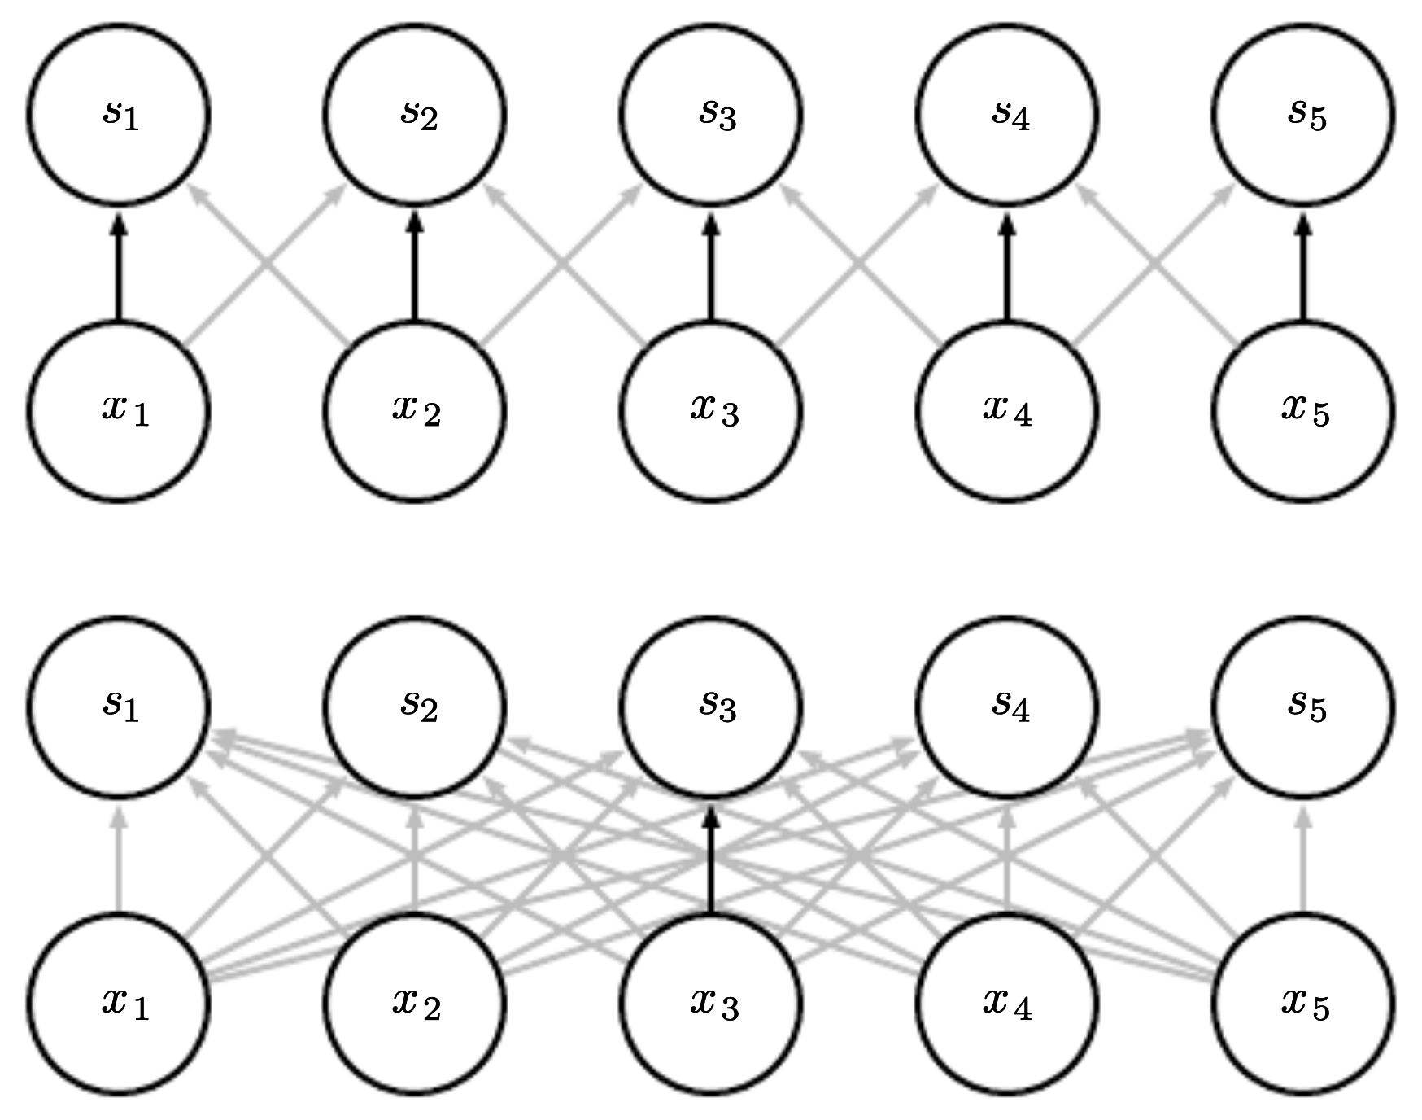
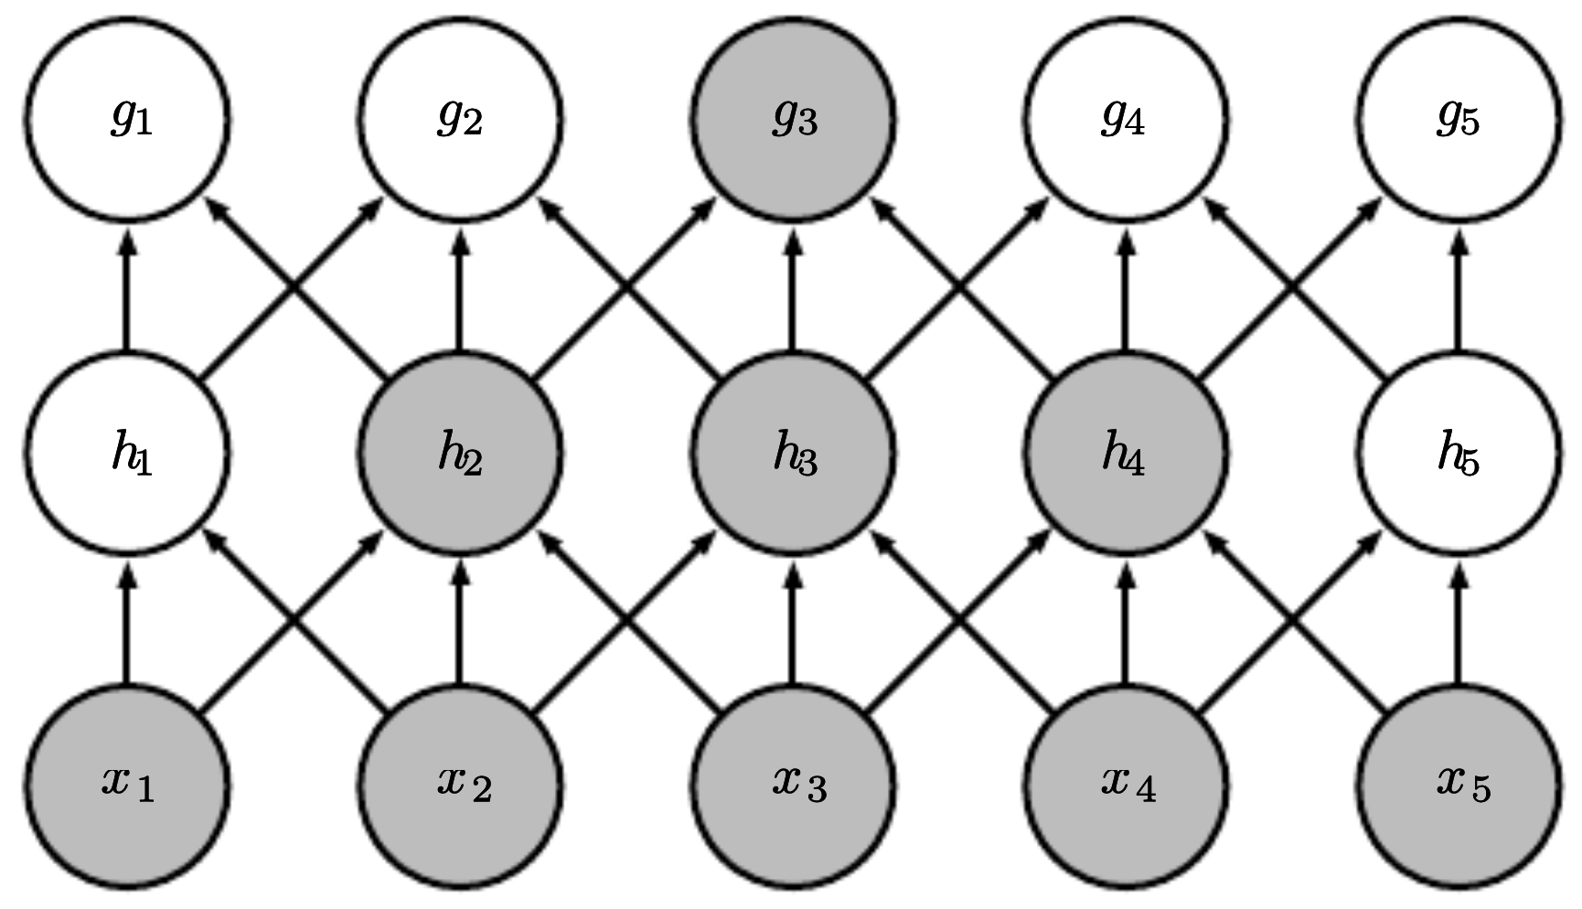
CNN
learned parameters (1D for time series)
max pooling:
from wikipedia
convolutional vs fully-connected layer:
source
input
source
1D for time series
source
receptive fields:
many images (training examples), potentially with several channels
down-sampling by convolutions and pooling
several kernels producing several feature maps

Slide 39
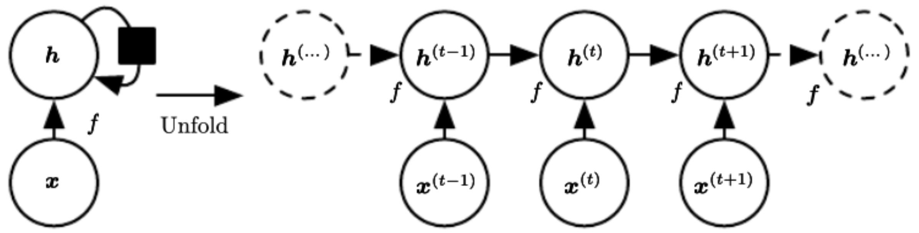
RNN: Back-Propagation through Time
activation of recurrent nodes at that point in time
interaction with delay of single time step
computational graph with repeated pieces:
hidden layer: several recurrent neurons
input layer:
NLP: one-hot encoded words or embeddings
time series: lagged target (e.g., sales) or exogenous time series (e.g., price)
single model operating on all time steps
source
parameter/weight sharing over time

Slide 40
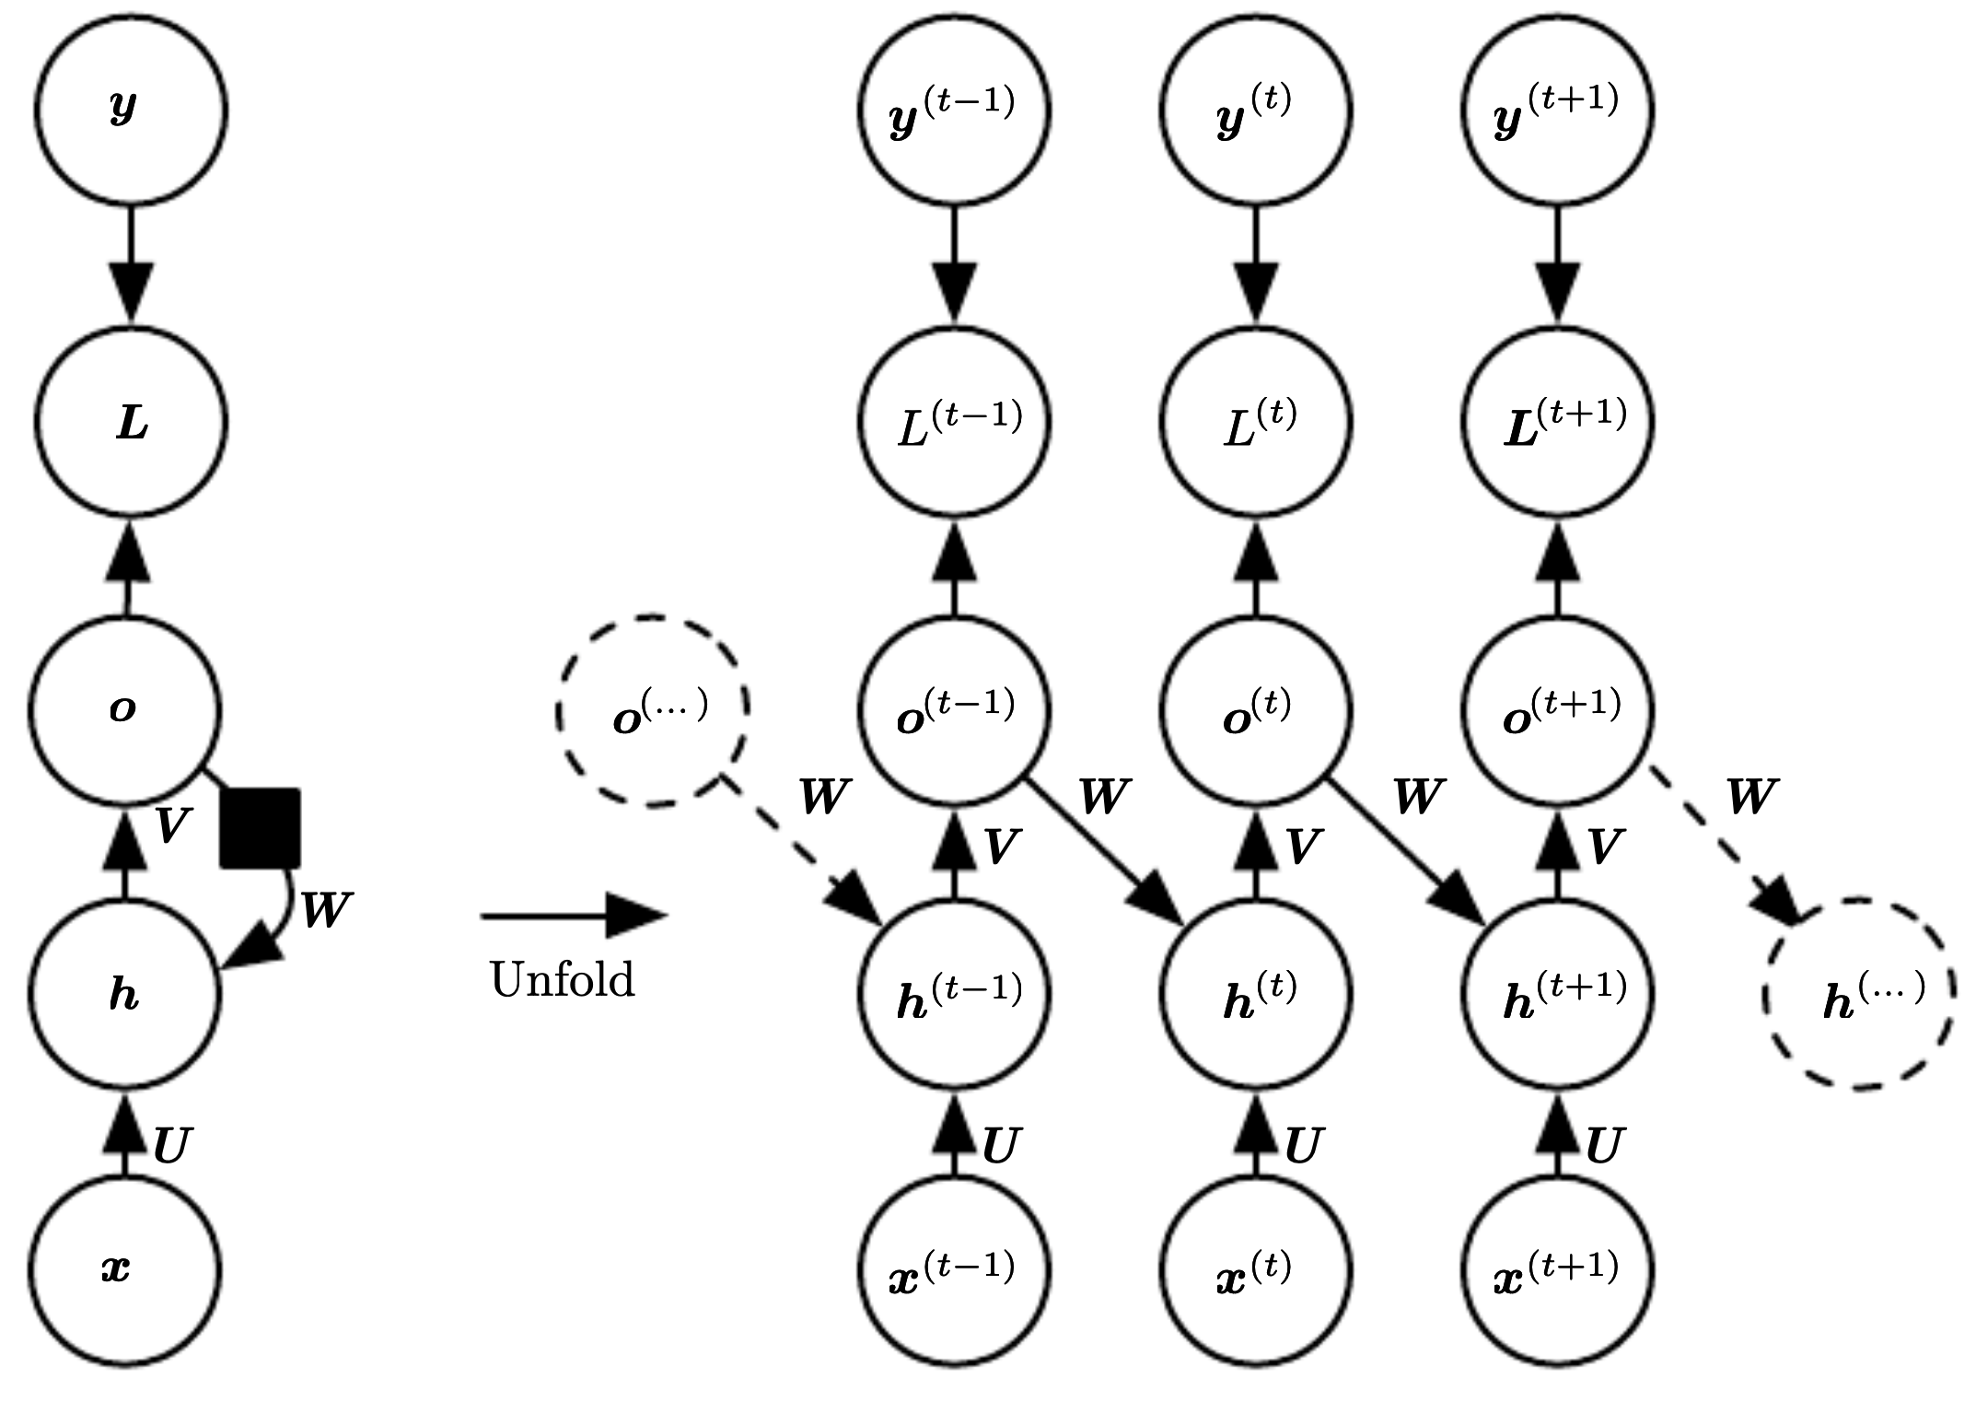
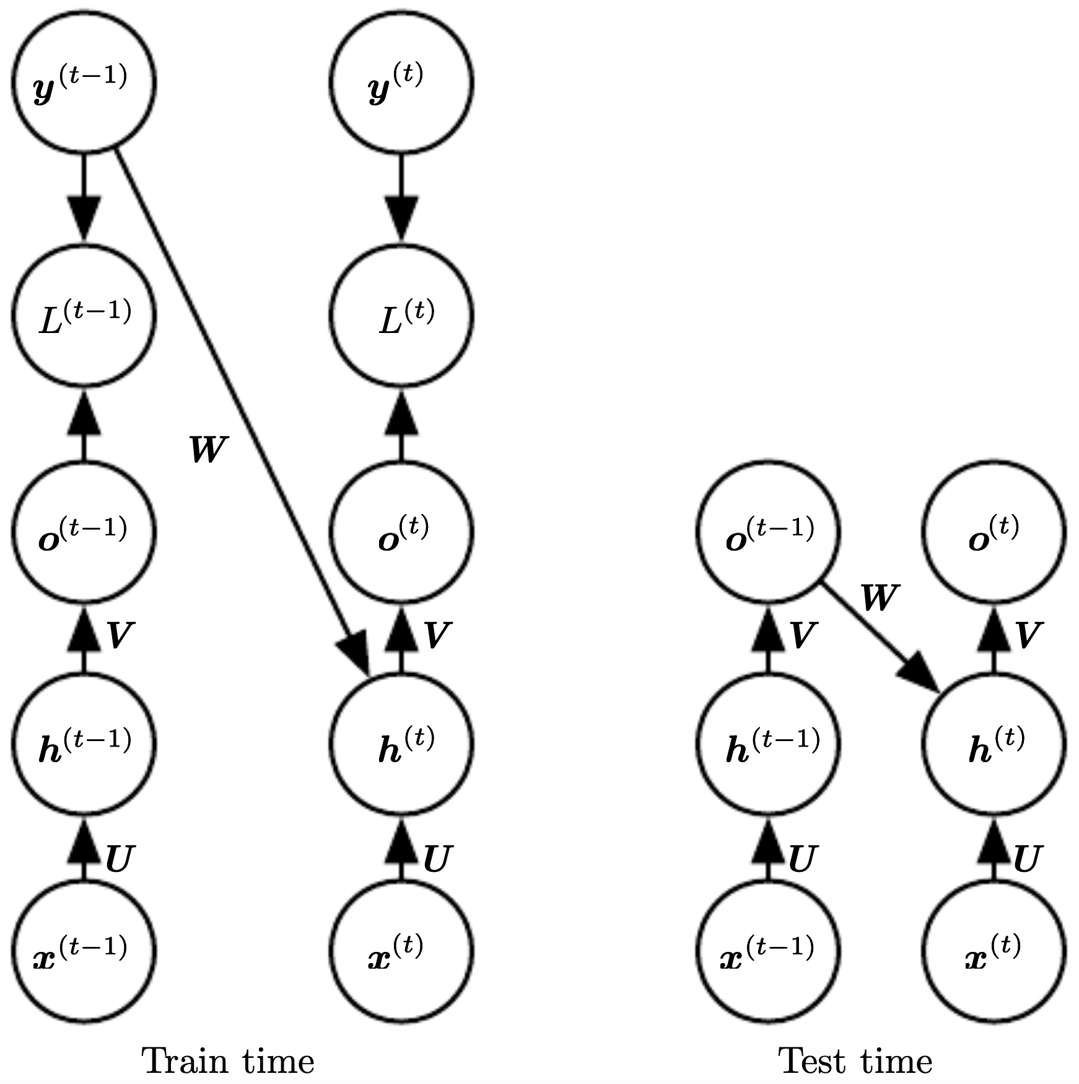
Teacher Forcing
instead of feeding model output back into itself, use target values directly for feedback from output to hidden layer
example demand forecasting: sales from day before (different to usage as input from last slide)
e.g., RNN:
steps depend on forecast horizon
source

Slide 41
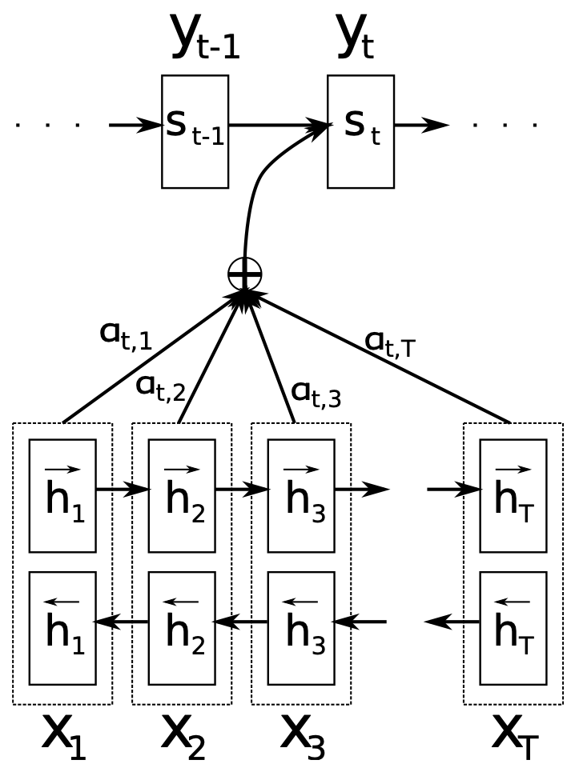


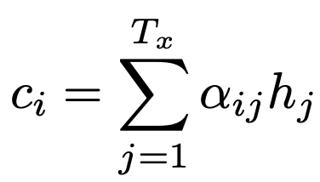
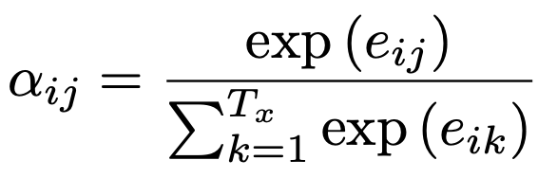
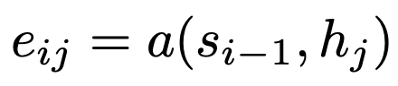
Transformer
attention:
multi-headed self-attention:
transformer:
needed due to permutation invariance of attention
source
source
source
time series: masked self-attention (only attending to past) → decoder-only (auto-regressive)

Slide 42
Demand Forecasting Subtleties

Slide 43
Censored Target
using sales data from past as target quantity to reflect unobservable demand
BUT: sales data correspond to censored demand due to
out-of-stock situations
markdown sales: reduced prices for items, e.g., nearing its best before date → increased sales compared to demand at usual, unreduced price
need for (probabilistic) target correction in these situations to enable unbiased demand forecasts

Slide 44
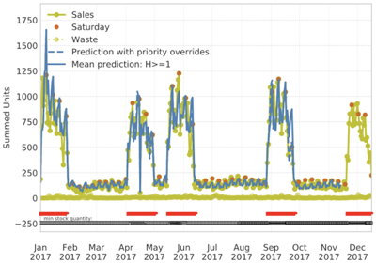
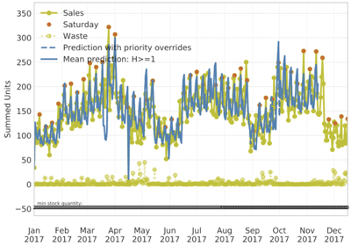
Cannibalization and Halo Effects
sales spikes in promotion (reduced price)
sample interactions: demand decreases (cannibalization) or increases (halo) due to other products in promotion at the same time
additional ML model(s) after demand forecasting
prediction residuals as target (all other effects captured)
learn individual effect for each product pair (product matrix with separate models for each row)
price reduction (or promotion flag) of different other products as features
feature selection to avoid overfitting (e.g., lasso)
Summed Units
sales drops for cannibalized products
Summed Units

Slide 45
Order Optimization: Need for PDF Predictions

Slide 46
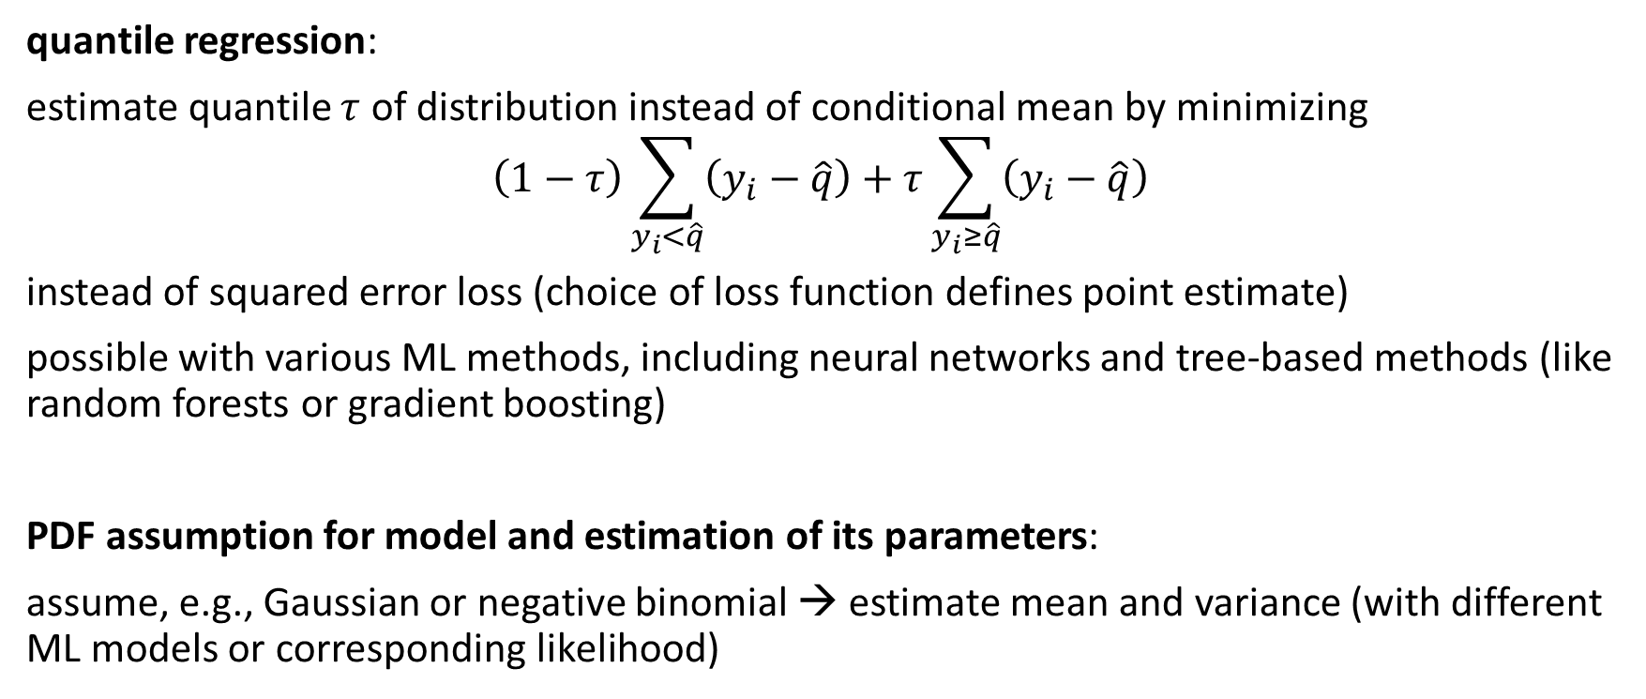
Prediction of Full Probability Distributions
quantile regression:
estimate quantile $τ$ of distribution instead of conditional mean by minimizing
$$\left(1−τ\right)\sum_{y_{i}<\hat{q}}{\left(y_{i}−\hat{q}\right)+τ\sum_{y_{i}≥\hat{q}}{\left(y_{i}−\hat{q}\right)}}$$
instead of squared error loss (choice of loss function defines point estimate)
possible with various ML methods, including neural networks and tree-based methods (like random forests or gradient boosting)
PDF assumption for model and estimation of its parameters:
assume, e.g., Gaussian or negative binomial → estimate mean and variance (with different ML models or corresponding likelihood)

Slide 47
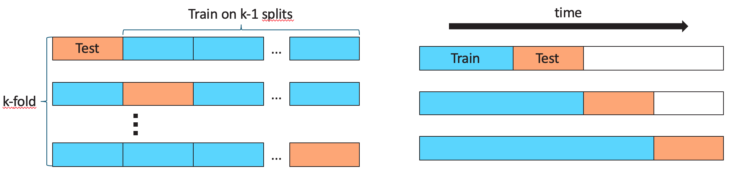
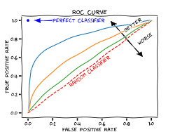
Model Evaluation
test structure
cross-validation:
decide on acceptance of model changes by accuracy measure: improved model vs baseline (current best)
measure (out-of-sample) accuracy of predictions (loss function in training as proxy of this)
regression
classification
point estimate: absolute (MAD, MSE, …) or relative (MAPE, …) metrics
full probability distribution: a bit tricky
from wikipedia

Slide 48
Evaluation of PDF Predictions: Histogram of CDF Observations
https://arxiv.org/abs/2009.07052
individual prediction/observation:
many (or all) predictions/observations:
predicted PDF
→ predicted CDF
for each sample
subtlety for discrete PDFs:
histogram filled using random numbers according to the CDF intervals (e.g., for 3 actual sales: random pick between discrete CDF values for 2 and 3)
observation (target)

Slide 49
Interpretation of CDF Histogram
if all is fine …
quantitative evaluation: measure deviation from uniform distribution (e.g., earth mover’s distance)

Slide 50
Replenishment
loss: deviation between predicted value and truth
demand forecasts in form of full, individual probability distributions
order proposals by individually choosing the quantile minimizing expected costs (scaled losses)
simplistic: order quantity = current inventory - upcoming demand
(ignoring delivery lead times and shrinkage beyond demand, e.g., waste)
potential add-on:
(probabilistic) inventory estimation
assumption for two-step approach:
demand (not sales) not affected by subsequent action of ordering
In fact, stock level can have small effects on demand. For example, full shelves might increase demand.

Slide 51
Need for Probability Distributions instead of mere Point Estimators
one best (usually different) quantile for each (out-of-sample) error measure
examples for error measures and their optimal point estimators:
mean squared error (MSE) optimized by mean
mean absolute error/deviation (MAD) optimized by median
but usually individual cost function for each product (possibly even for different dates of one product), → individual, optimal quantile as point estimator
possible approaches:
many quantile regressions: for each individual, optimal point estimator use corresponding loss function
full, individual probability distributions, i.e., probability density functions (PDF) for the continuous case

Slide 52
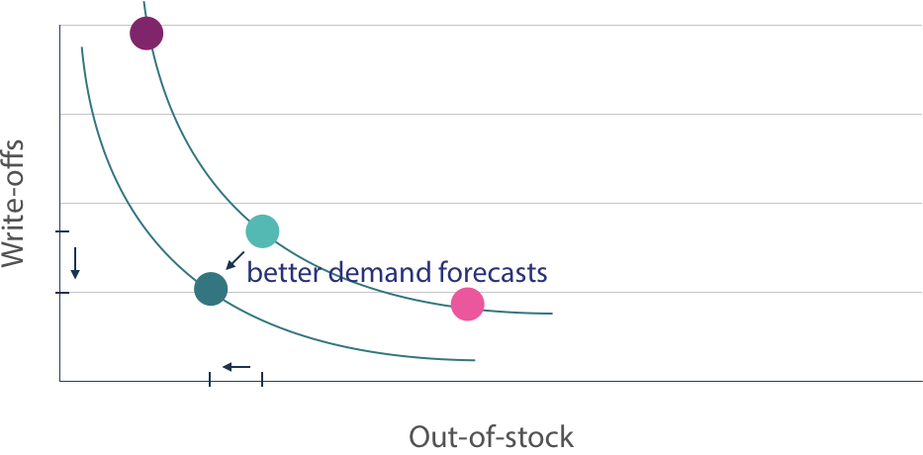
Order Optimization
costs refer to scaled demand losses: assign costs to out-of-stocks (lost sales), write-offs (waste), ...
full multi-dimensional cost function as sum of different costs
complete cost functions often not available in practice
→ simulate impact of quantile choice on different KPIs (by means of full PDF predictions)
less out-of-stocks, but more write-offs
less write-offs, but more out-of-stocks
choose low quantile for ordering:
high understock risk
choose high quantile for ordering:
high overstock risk

Slide 53
Demand Shaping: ML and Causality

Slide 54
Data-Generating Process
story behind the data as important as the data itself
Why are the statistical dependencies as observed?
data-generating process mostly governed by causal dependencies
but language of algebra symmetric
no way to tell that a storm causes barometer to go down and not the other way around → need for asymmetric mathematical language

Slide 55
The Ladder of Causation
III imagining counterfactuals What if I had done ...? Why?
II doing intervention What if I do ...? How?
I seeing association What if I see ...? → Realm of ML
from The Book of Why (Pearl, MacKenzie)

Slide 56
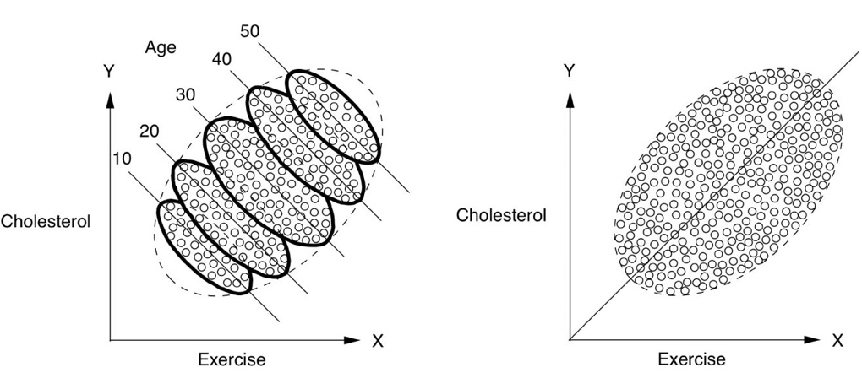
Simpson’s Paradox
example: monthly sales of a fashion article in different shops during winter season
Lower price yields higher sales for each month individually, but lower sales overall?
months since start of season
1
2
3
4
5
sales
sales
from The Book of Why (Pearl, MacKenzie)
price
price

Slide 57
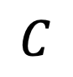
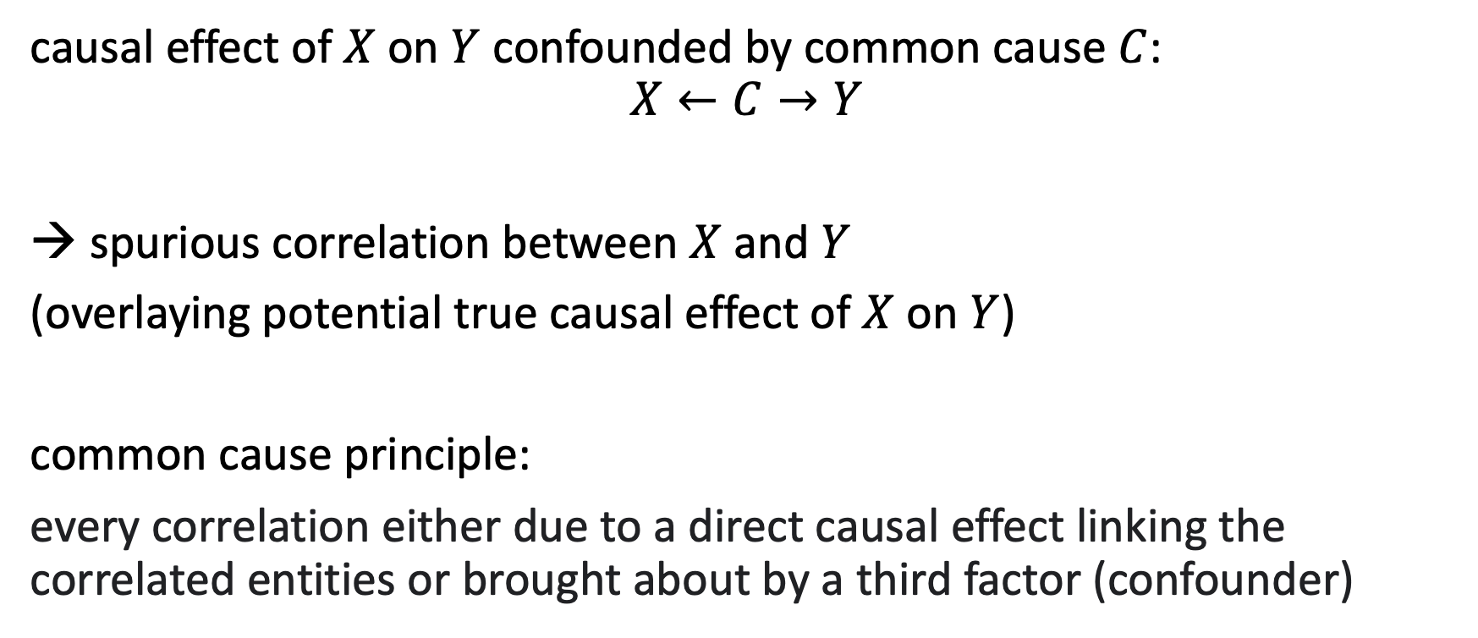
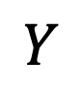

Confounding
causal effect of $X$ on $Y$ confounded by common cause $C$:
$$X←C→Y$$
spurious correlation between $X$ and $Y$
(overlaying potential true causal effect of $X$ on $Y$)
common cause principle:
every correlation either due to a direct causal effect linking the correlated entities or brought about by a third factor (confounder)
$$C$$
$$X$$
$$Y$$

Slide 58
Confounders for Pricing
price setting for a product can be considered a demand shaping method
the idea is a causal effect: lower price leads to higher demand
→ by estimating this causal effect one can find an optimal price according to a given policy (like maximizing profit)
problem: confounders influencing both pricing in past (obverved) data and demand, e.g., lowering prices on weekends only for grocery or lowering prices toward end of a season for fashion (most sales at beginning of season)

Slide 59
Counterfactuals
fundamental problem of causal inference:
only one realization: What happened? And what could have happened instead?
cannot observe different potential outcomes (individual causal effect)
example for application of causal what-if scenario:
individual (e.g., per product-location-date combination) demand shaping via price setting
ML and data not enough to describe causal structure
need for causal assumptions as add-on to ML (going beyond curve fitting)

Slide 60



Demand Shaping with Causal Inference
dynamic pricing: influencing demand of different products by price setting
customer targeting: influence individual customer demand by sending coupons
confounded effect:
after de-confounding:
use for pricing policies:
usually exponential

Slide 61
Potential Outcomes with ML
deconfounding
by RCTs or
independence weights (inverse propensity scores)
prediction of individual causal effect with ML model
(generalization by function approximation)

Slide 62





Independence Weights with ML
$$C$$
$$X$$
$$Y$$
scenario: $X$ binary (for simplicity), several confounders $C$
aim: prediction of individual causal effect using observational data only
ML model to predict past action policy $P\left(X|C\right)$ (beware: need to include all $C$)
inverse propensity score weighting of each unit (to adjust for multiple confounders):
train ML model on deconfounded data to predict $Y$ with $X$ and $C$ as features
individual causal effect as difference between predictions for setting feature $x=1$ and $x=0$, respectively (what-if scenario)
alternative:
A/B test
$$P\left(Y | do\left(X\right)\right)=\sum_{z}{P\left(Y | X,Z=z\right) P(Z=z)}=\sum_{z}{\frac{P(Y,X,Z=z)}{P(X|Z=z)}}$$

